Slide 1
Aviation Merit Badge Scouting America

Slide 2
What Is An Aircraft?
An aircraft is a vehicle that can fly by being supported by the air
Two main types are lighter than air vehicles and heavier than air vehicles
Aircraft can also be powered and un-powered
Aircraft can also be manned or un-manned
(Requirement 1a)

Slide 3
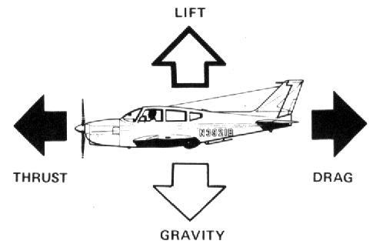
Forces on an Airplane
Flight is the result of the balance of these forces
(Requirement 1b)
Notes:
What happens when two people push on opposite sides of the same thing? It moves in the direction of the stronger push.

Slide 4
How is Lift Created?
(Requirement 1b)
Notes:
You know what gravity is. Lift has to overcome gravity for the airplane to stay in the air. Different types of aircraft create lift in different ways.

Slide 5
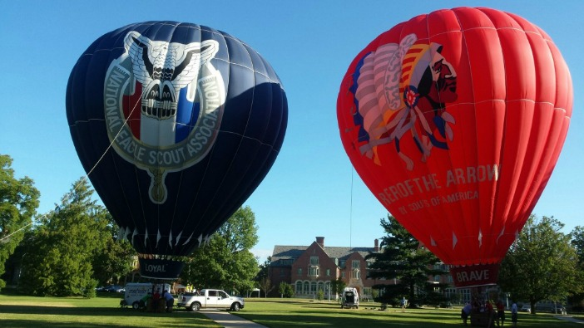
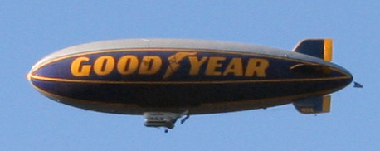
Lighter Than Air Aircraft
Lift is created by hot air or gases that are less dense than air.
(Requirement 1b)
Notes:
Lighter than air aircraft create lift using hot air or gases that are less dense than air.

Slide 6
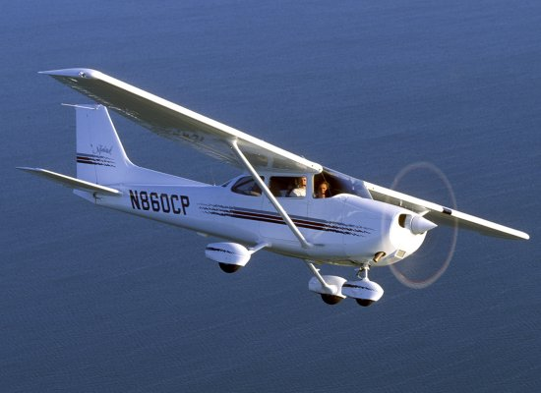
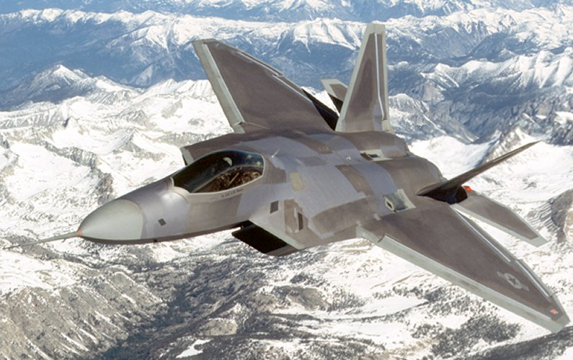
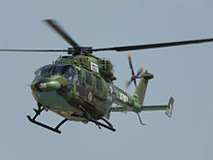
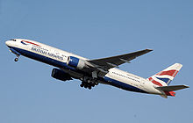
Heavier Than Air Aircraft
Wings produce lift
(Requirement 1b & 1c)
Notes:
The wings create lift for heavier than air aircraft.

Slide 7
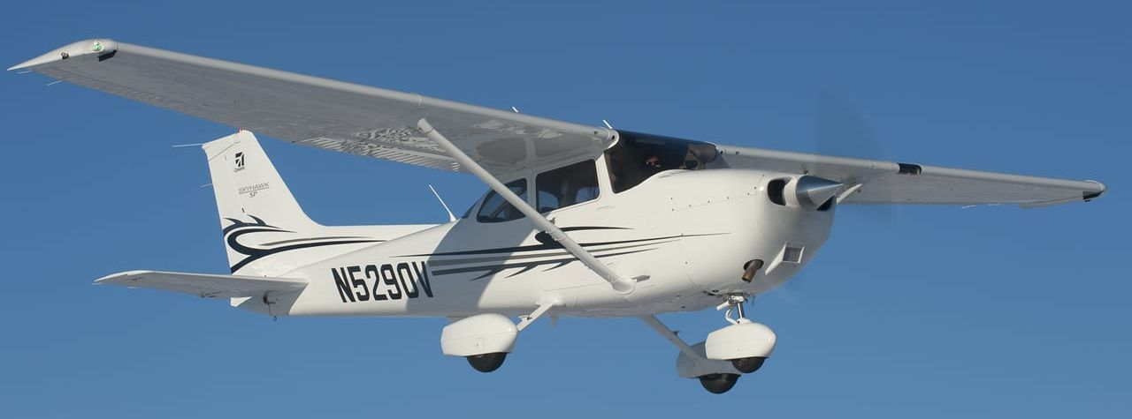
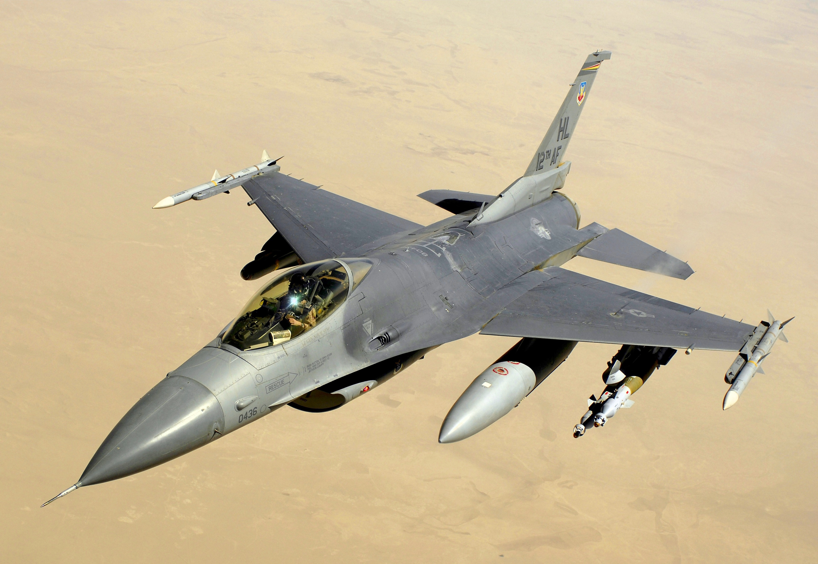
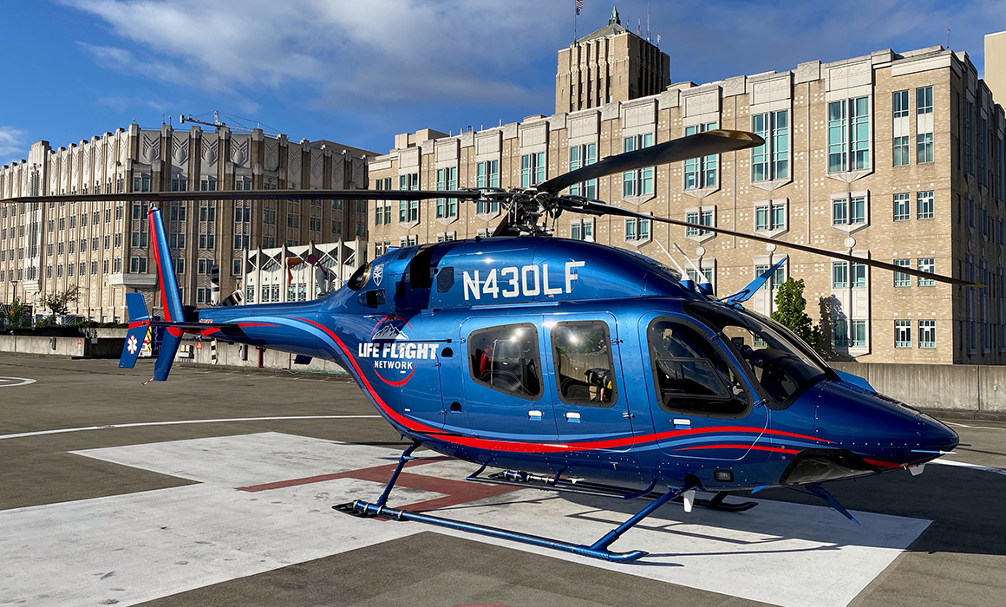
Heavier Than Air Aircraft
Fixed Wing vs Rotary Wing
(Requirement 1b & 1c)
Notes:
Different types of wings: Fixed wing and rotary wing

Slide 8
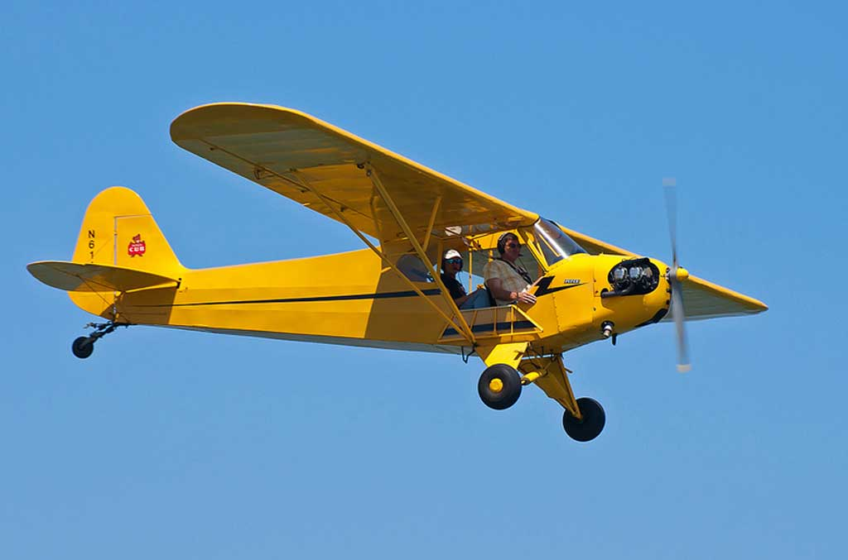
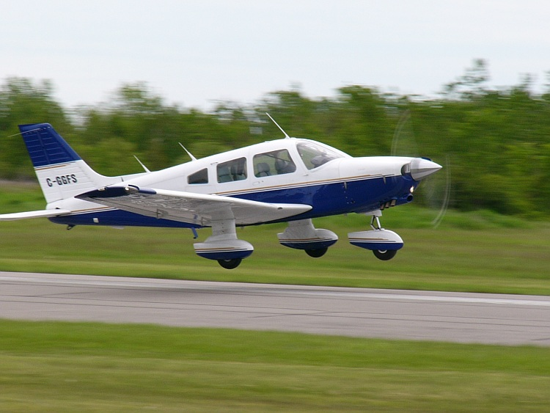
Heavier Than Air Aircraft
High Wing vs Low Wing
(Requirement 1b & 1c)
Notes:
Different types of wings: high and low

Slide 9
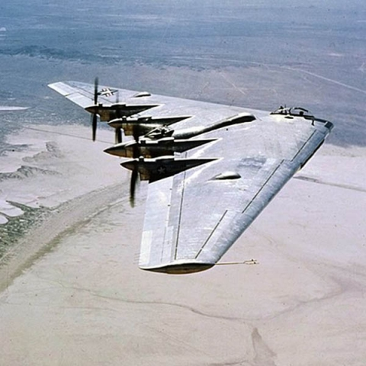
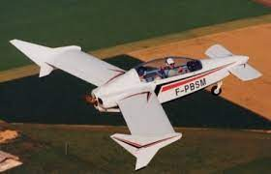
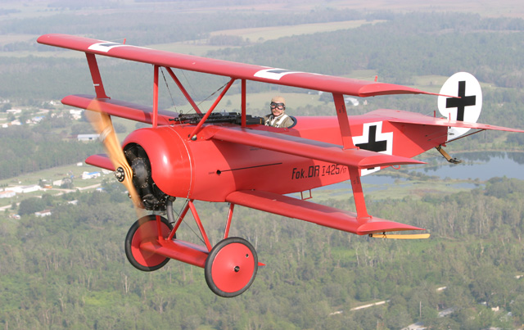
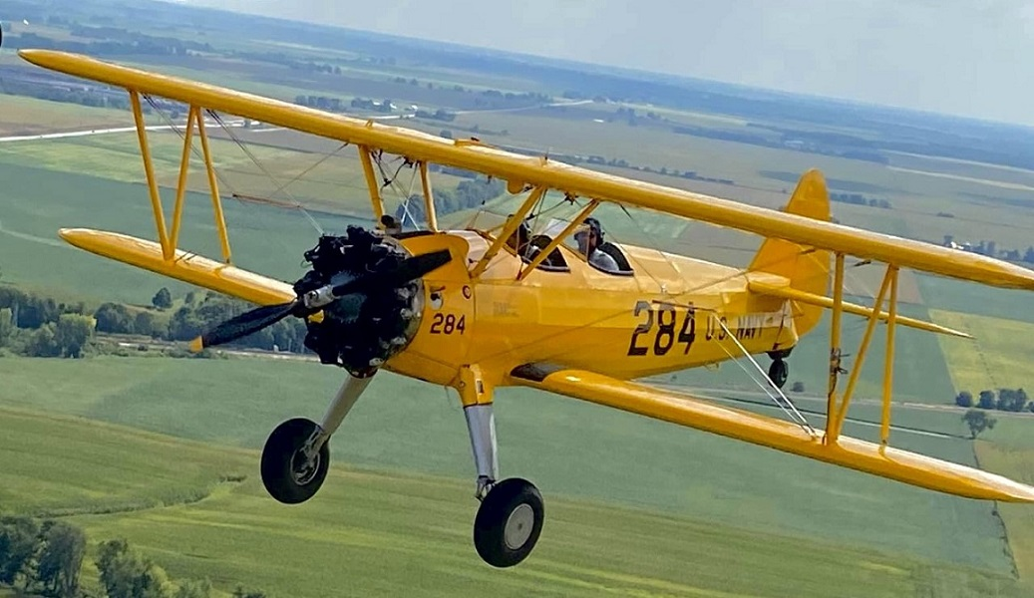
Heavier Than Air Aircraft
Different Wings
(Requirement 1b & 1c)
Notes:
Aeronautical engineers have designed many different types of wings. They have experimented with wing shape, placement, and even how many there are.

Slide 10
Heavier Than Air Aircraft
Wings produce lift
(Requirement 1b & 1c)
Notes:
All the types of wings have one thing in common – they are designed to produce lift.

Slide 11
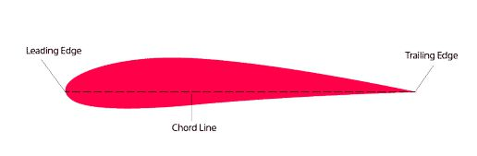
How Do Wings Produce Lift?
Airfoil
(Requirement 1c)
Notes:
An airfoil is a special shape that will produce lift when it’s moved through the air in the right direction. The bottom is flatter, and the top is more curved. The leading edge (front) is thicker, and the trailing edge (back) is thinner. An airplane wing is an airfoil.

Slide 12
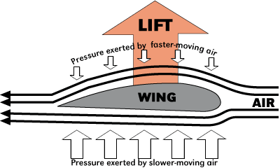
How Do Wings Produce Lift?
Bernoulli’s Principle
as the velocity of a fluid increases, its pressure decreases
(Requirement 1c)
Notes:
When lift is stronger than gravity, the aircraft goes up. When gravity is stronger, the aircraft goes down.
Explain how an airfoil generates lift. Daniel Bernoulli, an eighteenth-century Swiss scientist, discovered that as the velocity of a fluid increases, its pressure decreases.
Bernoulli’s principle applies to any fluid, and since air is a fluid, it applies to air.
If you can cause the air to move faster on one side of a surface, the pressure on that side of the surface is less than that on its other side.
When air hits the leading edge of the wing, it splits; some of the air moves under the wing, and some of it goes over the top. The air moving over the top of the curved wing must travel farther to reach the trailing edge, so it has to travel faster than the air moving under the wing at the same time. Faster air = lower pressure; the air pressure on the top of the wing is less than the air pressure on the bottom of the wing. The stronger pressure on the bottom pushes the wing up in the air, which is lift.

Slide 13
How is Drag Created?
Caused by airflow over surfaces
(Requirement 1c)
Notes:
Drag slows down the airplane. What causes drag?

Slide 14
How is Thrust Created?
(Requirement 1c)
Notes:
To move forward, thrust needs to be stronger than drag.

Slide 15
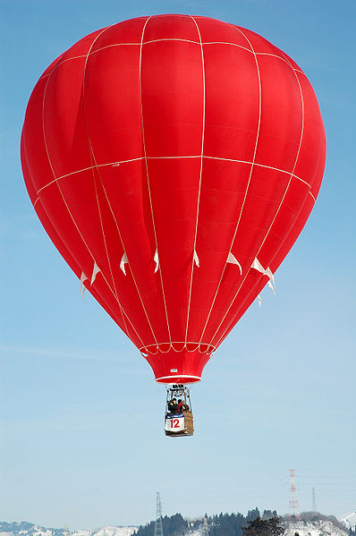
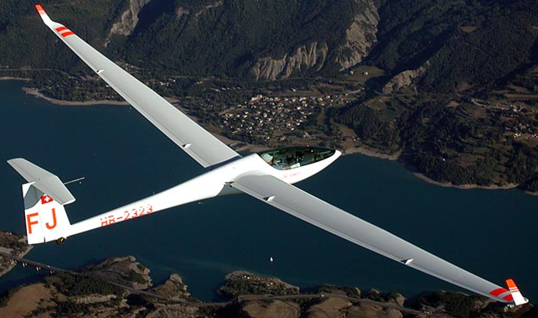
Un-Powered Aircraft
No thrust created by the aircraft
– where does it come from?
(Requirement 1c)
Notes:
The wind creates thrust to move a hot air balloon. A tow plane provides initial thrust for a glider.

Slide 16
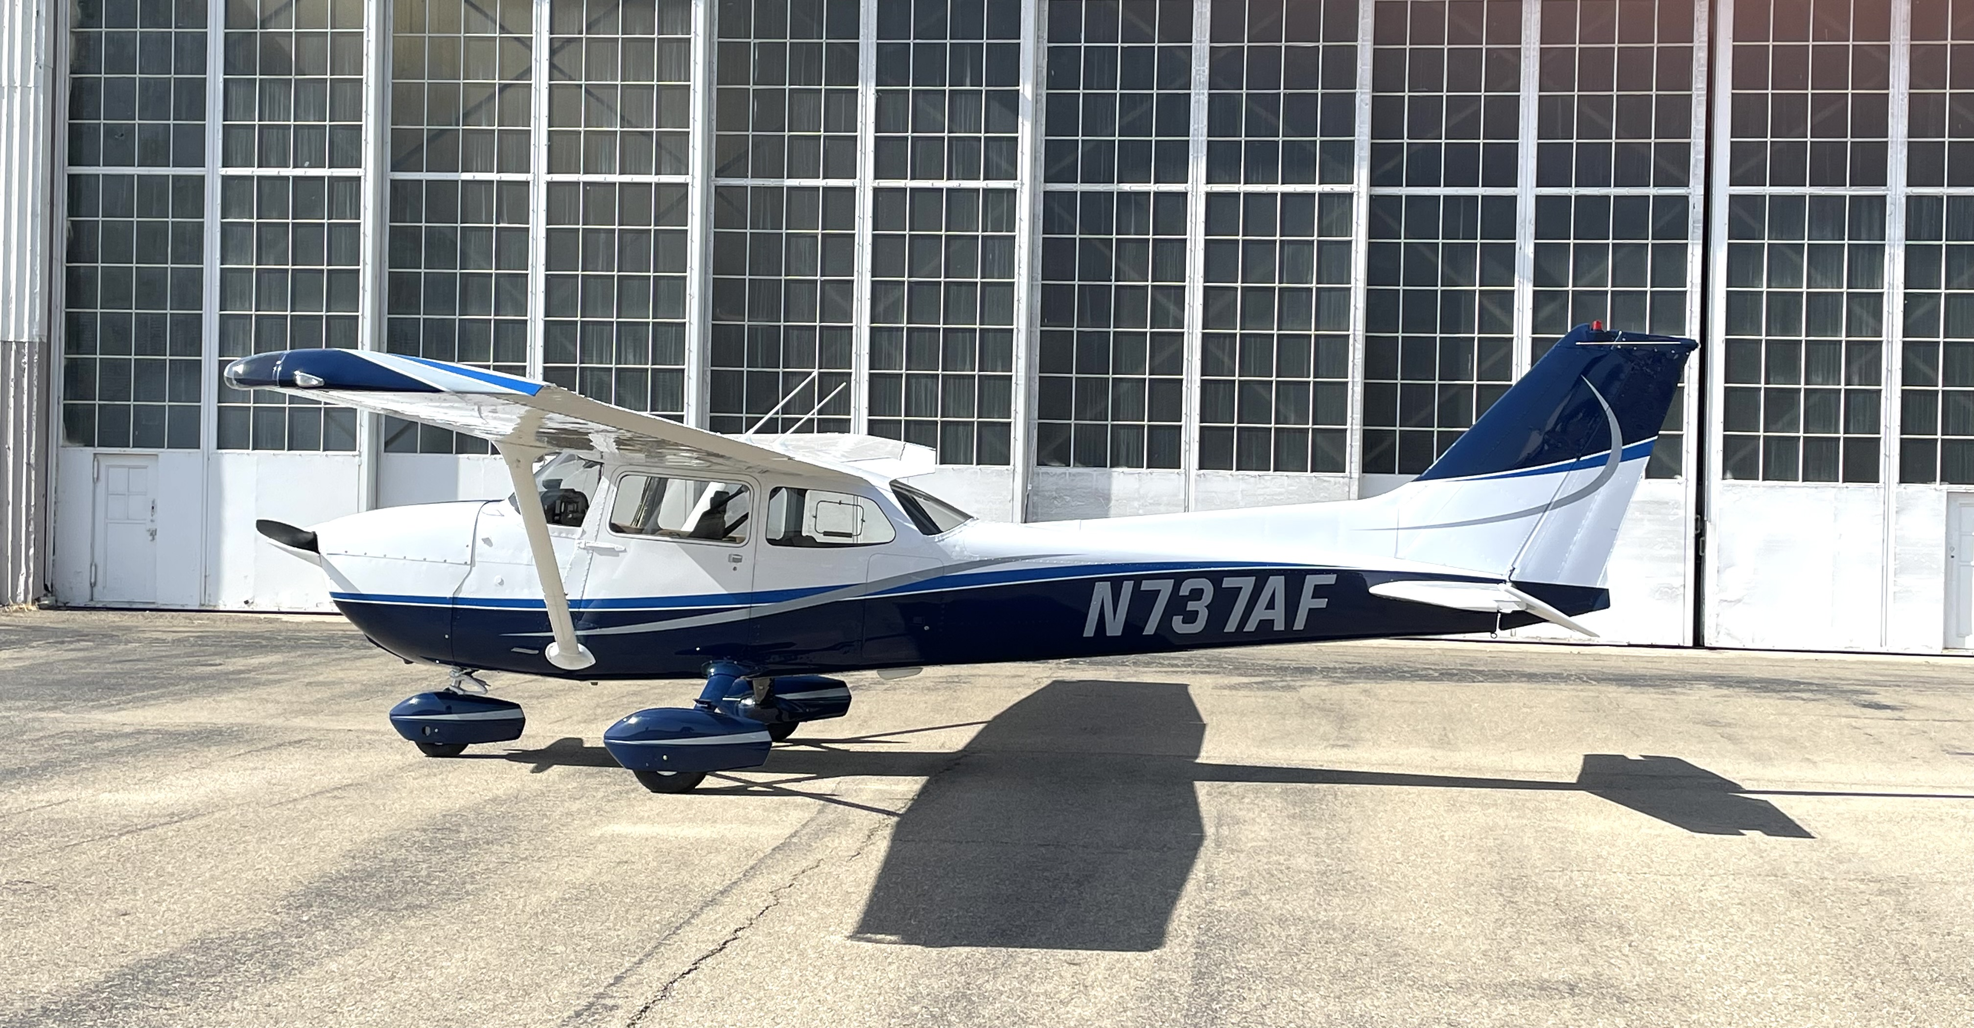
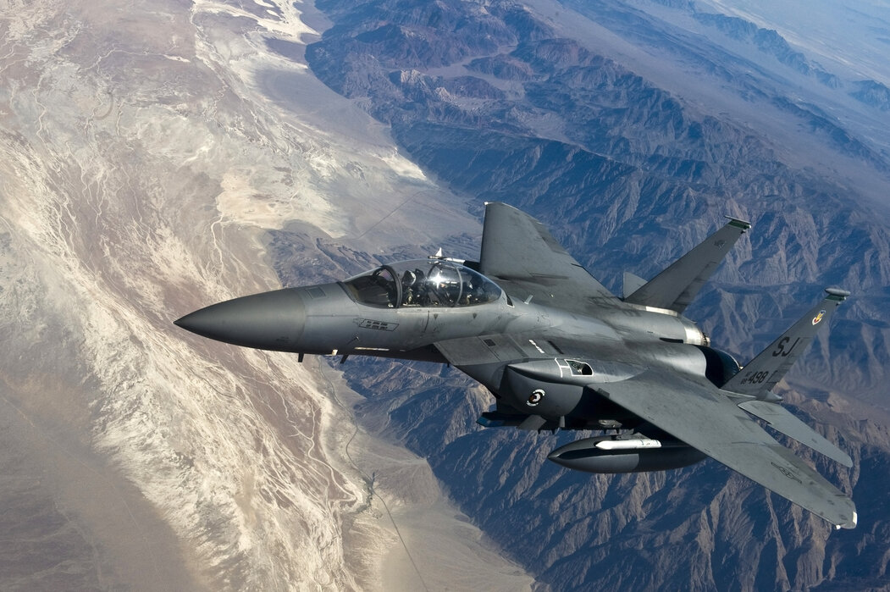
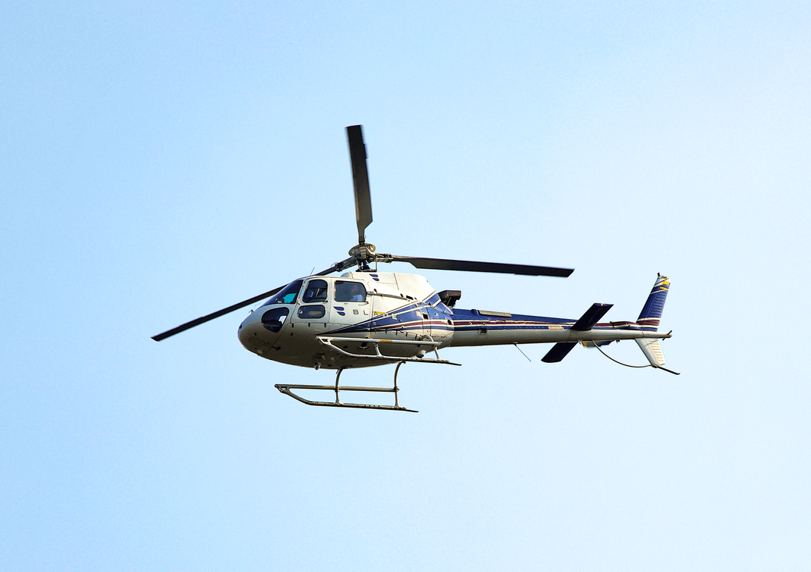
Powered Aircraft
Thrust is created by the powerplant
(Requirement 1c)
Notes:
In powered aircraft, thrust is created by the powerplant (motor).

Slide 17
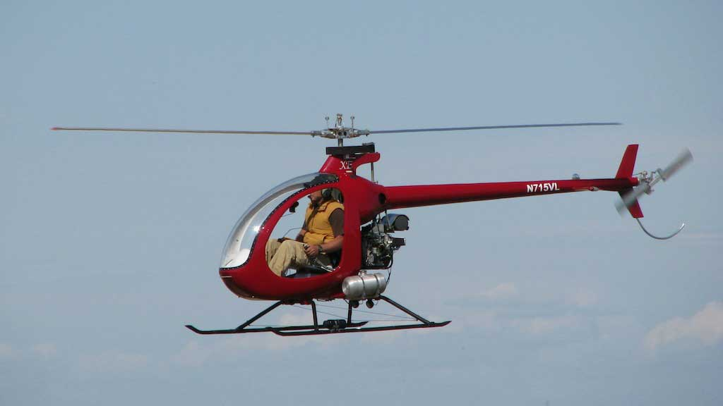
Types of Powerplants
Piston Prop Engines
Turboprop Engines
Jet Engines
(Requirements 1a & 1c)
Notes:
The three most common types of aircraft powerplants are piston prop engines, turboprop engines, and jet (turbine) engines.

Slide 18
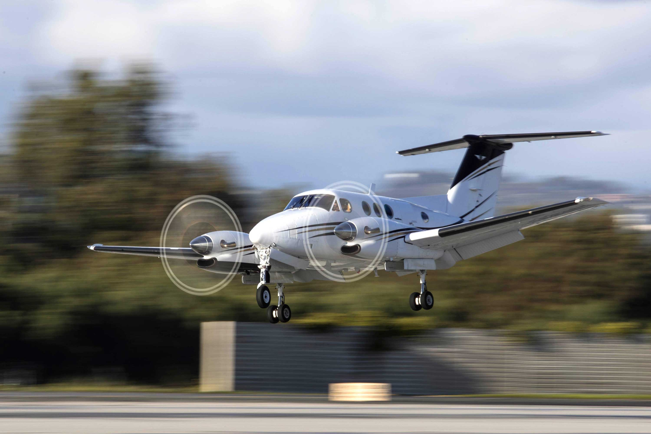
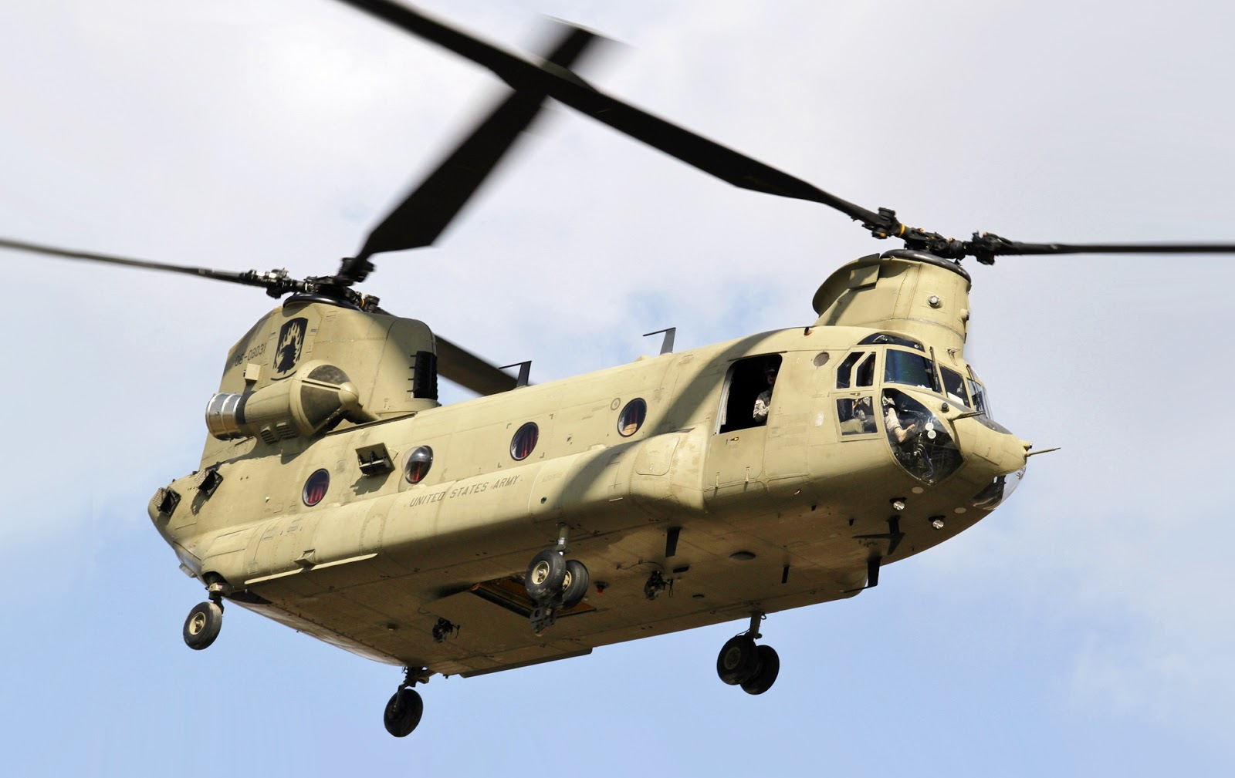
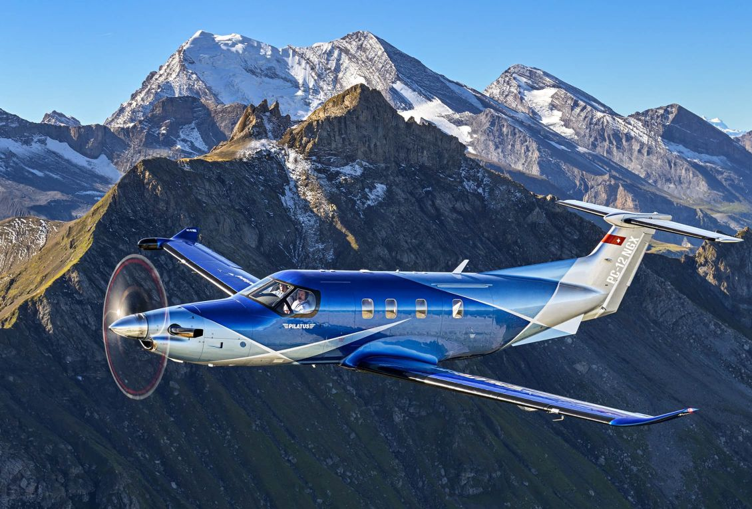
Types of Powerplants
Piston Prop Engines
Turboprop Engines
Jet Engines
(Requirements 1a & 1c)
Notes:
The three most common types of aircraft powerplants are piston prop engines, turboprop engines, and jet (turbine) engines.

Slide 19
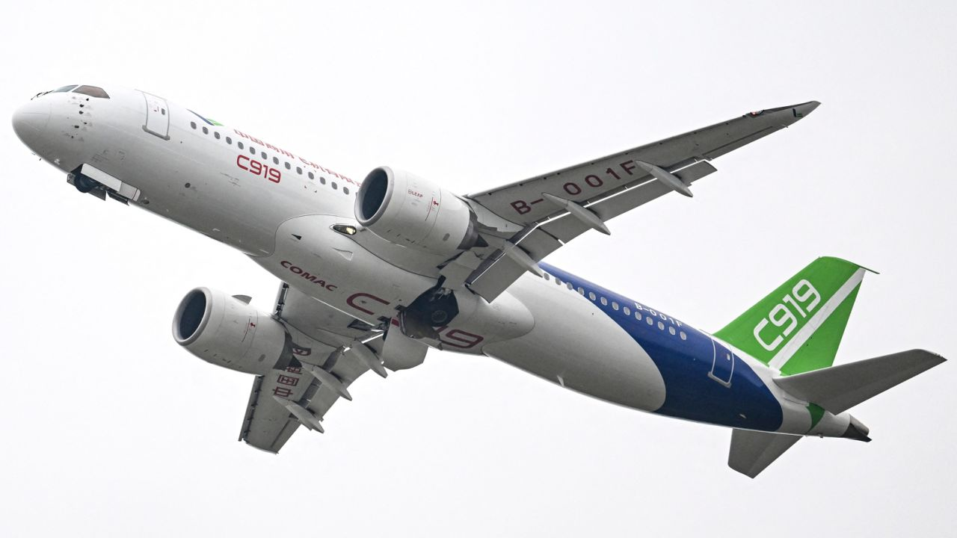
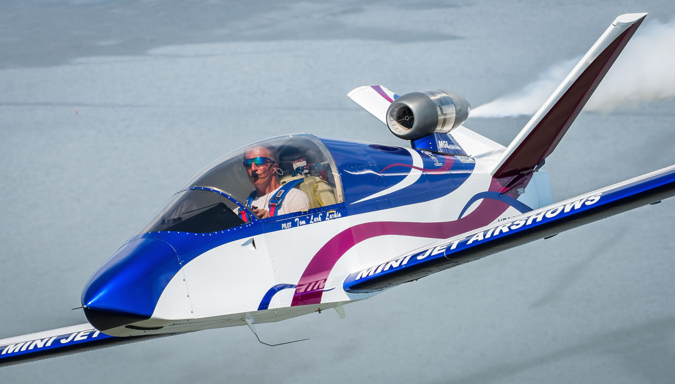
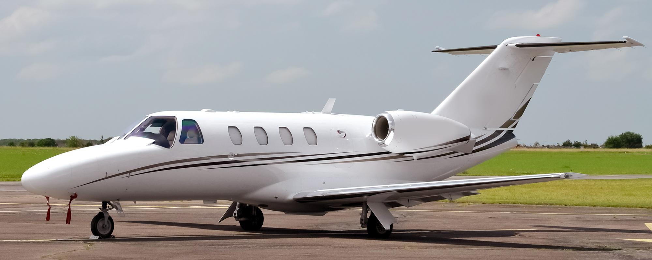
Types of Powerplants
Piston Prop Engines
Turboprop Engines
Jet Engines
(Requirements 1a & 1c)
Notes:
The three most common types of aircraft powerplants are piston prop engines, turboprop engines, and jet (turbine) engines.

Slide 20
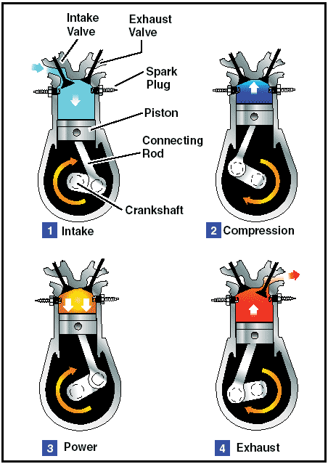
Types of Powerplants
Piston Prop Engines
Similar to a car engine
Thrust is produced by the propeller
(Requirements 1a & 1c)

Slide 21
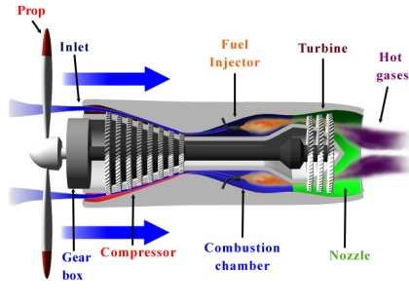
Types of Powerplants
Turboprop Engines
Mix of propeller and jet engine
Thrust is produced mostly by propeller(s)
(Requirements 1a & 1c)

Slide 22
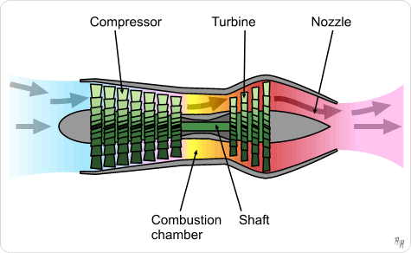
Types of Powerplants
Jet Engines
Thrust is produced by jet exhaust
(Requirements 1a)

Slide 23
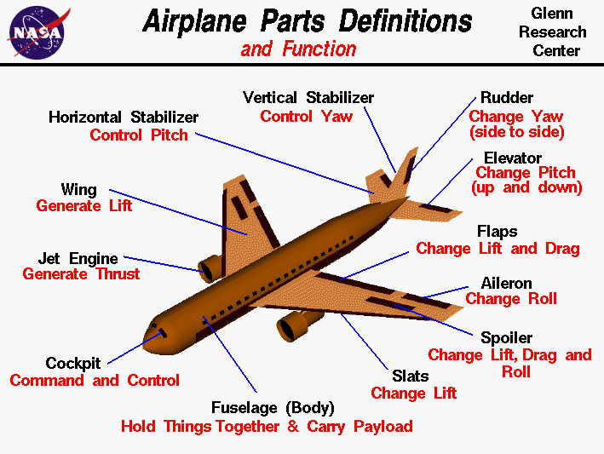
How are Aircraft Controlled?
(Requirement 1c)
Notes:
A plane has parts on its wings and tail called control surfaces that control how it maneuvers through the air. Control surfaces are the moveable outer surfaces of an airplane. These surfaces control the flow of air over the various sections of the aircraft causing it to move in different ways. The pilot controls how the control surfaces move.
If you get your pilot’s license, you’ll learn about all the parts of an airplane on this drawing. Right now we’re going to focus on just the three main control surfaces . . .

Slide 24
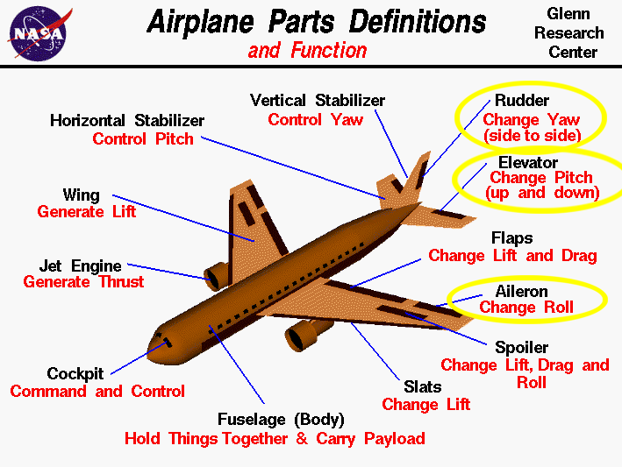
How are Aircraft Controlled?
(Requirement 1c)
Notes:
The rudder, elevator, and ailerons.

Slide 25
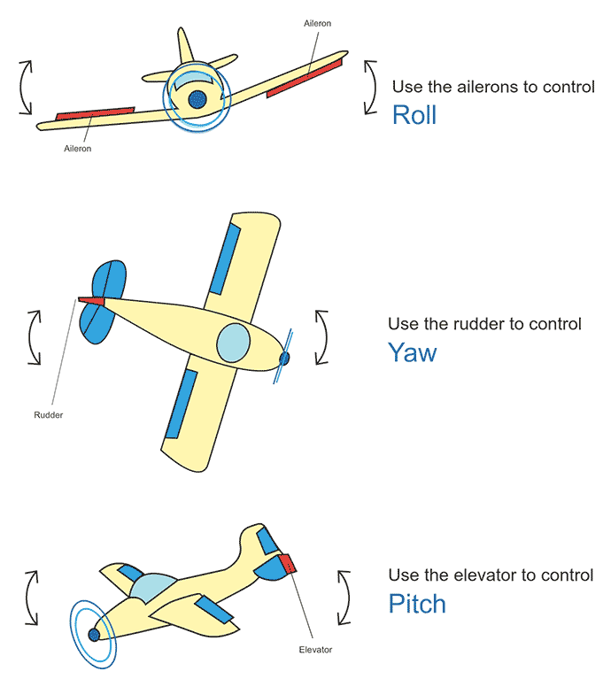
Directional Control
YAW
PITCH
ROLL
(Requirement 1c)
Notes:
Cars go only left or right, but planes must be steered up or down as well. An airplane in flight changes direction by movement around one or more of its three axes of rotation: lateral axis (yaw), vertical axis (pitch), and longitudinal axis (roll). These axes are imaginary lines that run perpendicularly to each other through the exact weight center of the airplane. The airplane’s rotation around them is called pitch, roll, and yaw. The pilot guides the airplane by controlling pitch, roll, and yaw, and by use of the elevators, ailerons, and rudder.
YAW Rudder rotates the airplane around vertical axis.
ROLL Ailerons rotate the airplane around longitudinal axis.
PITCH Elevators rotate airplane around lateral axis.

Slide 26
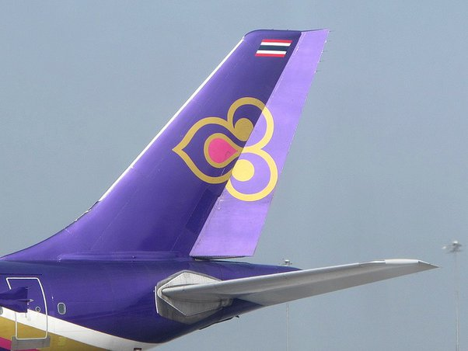
YAW – Rudder – Vertical Axis
Rudder
Vertical part of the tail that can move from side to side.
(Requirement 1c)
Notes:
Rudder: The rudder is the vertical part of the tail that can move from side to side.

Slide 27
YAW – Rudder – Vertical Axis
Rudder
Vertical part of the tail that can move from side to side.
Controls yaw (nose direction).
(Requirement 1c)
Notes:
Rudder: It controls the yaw, also called the vertical axis, or the direction the nose is pointing.

Slide 28
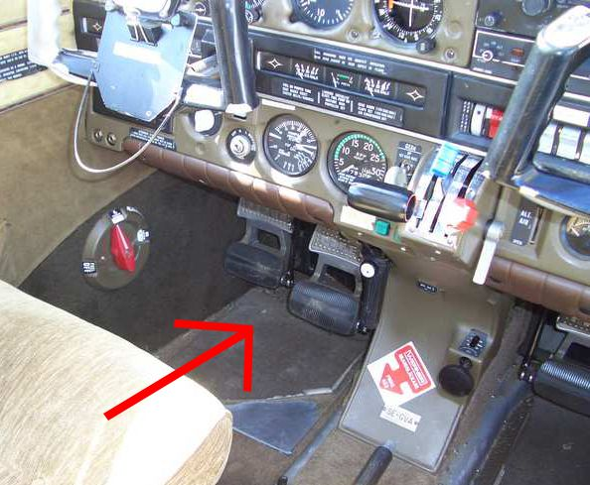
YAW – Rudder – Vertical Axis
Rudder
Vertical part of the tail that can move from side to side.
Controls yaw (nose direction).
Controlled by foot pedals.
(Requirement 1c)
Notes:
Rudder: The foot pedals are connected by means of wires or hydraulics to the rudder of the tail section. Pressing on the left rudder pedal moves the nose of the airplane to the left. Pressing on the right rudder pedal moves the nose to the right.

Slide 29
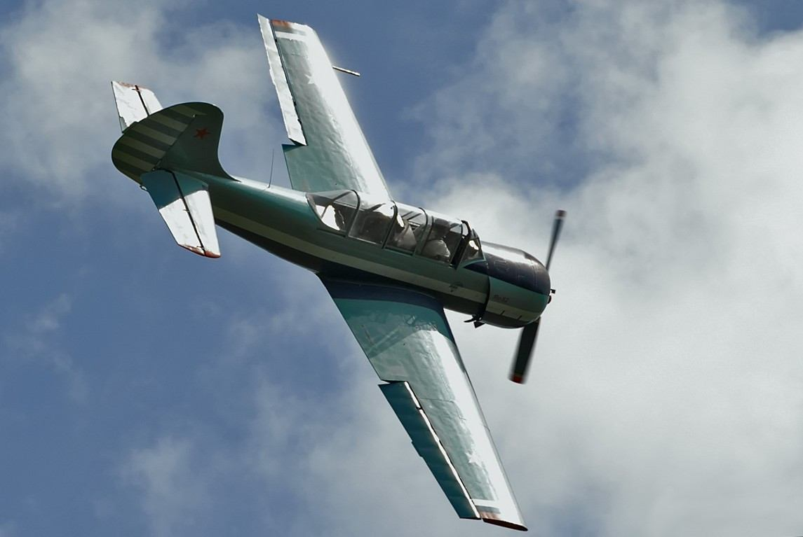
ROLL – Ailerons – Longitudinal
Ailerons
Movable airfoil at the trailing edge of an airplane wing.
Move in opposite directions.
(Requirement 1c)
Notes:
An aileron is a movable airfoil at the trailing edge of an airplane wing that controls the roll (longitudinal axis).
It’s attached to the wing by large hinges.
The two ailerons always move opposite each other. If one is up, the other one is down.

Slide 30
ROLL – Ailerons – Longitudinal
Ailerons
Movable airfoil at the trailing edge of an airplane wing.
Move in opposite directions.
Control roll (banking).
(Requirement 1c)
Notes:
Roll, or banking, is what makes an airplane really turn.
It’s like turning just your head/shoulders vs. turning your hips.

Slide 31
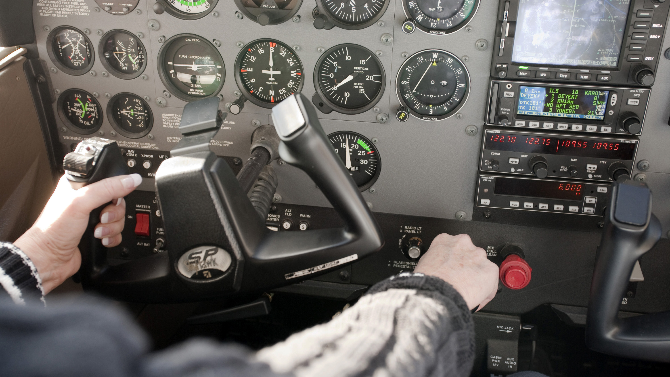
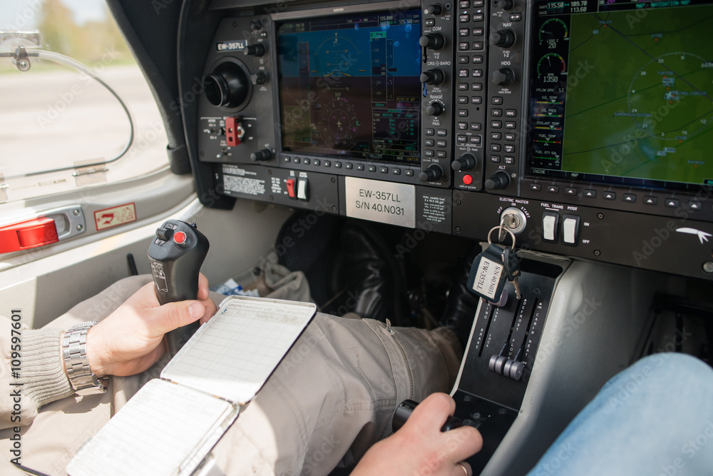
ROLL – Ailerons – Longitudinal
Ailerons
Movable airfoil at the trailing edge of an airplane wing.
Move in opposite directions.
Control roll (banking).
Controlled by the yoke or stick, turned/pulled to the side.
Notes:
The yoke/stick is connected by means of wires or hydraulics to the wings’ ailerons. By turning the yoke/stick, the pilot can change the positions of the ailerons.
When the control wheel is turned to the right, the right aileron goes up and the left aileron goes down, rolling the airplane to the right.
When the control wheel is turned to the left, the right aileron goes down and the left aileron goes up, rolling the airplane to the left.

Slide 32
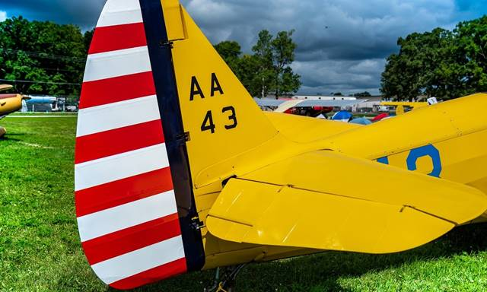
PITCH – Elevators – Lateral Axis
Elevators
Horizontal control surface, usually on the tail, that controls the plane's pitch.
Move together.
(Requirement 1c)
Notes:
The elevators control the airplane’s pitch. The elevators move together. They will go up together, down together, and neutral together.

Slide 33
PITCH – Elevators – Lateral Axis
Elevators
Horizontal control surface, usually on the tail, that controls the plane's pitch.
Move together.
Control pitch
(Requirement 1c)
Notes:
Pitch makes the nose move up or down compared to the horizon.

Slide 34
PITCH – Elevators – Lateral Axis
Elevators
Horizontal control surface, usually on the tail, that controls the plane's pitch.
Move together.
Control pitch
Controlled by the yoke or stick, pulled back or pushed forward.
(Requirement 1c)
Notes:
The yoke/stick is connected by means of wires or hydraulics to the elevators. By moving the stick, the pilot can change the position of the elevators.
When the control is pushed forward, the elevators move down, pitching the tail of the airplane up and the nose down, rolling the airplane down.
When the control is pulled back, the elevators move up, pitching the tail of the airplane down and the nose up, rolling the airplane upwards.

Slide 35
Chair Flying: Takeoff
Control |  | Action
Throttle (thrust) | Knob | Full power
Elevators (pitch) | Yoke | Pull back, then adjust as needed
Ailerons (roll) | Yoke | Level
Rudder (yaw) | Pedals | Right
(Requirement 1d)
Notes:
We’re going to do some chair flying. Student pilots often use chair flying to practice when they can’t fly an actual airplane.
Sit straight in your chair with your heels on the ground, and pretend to hold a yoke in front of you with your left hand. You will pretend to push or pull the throttle (a knob) with your right hand.
Why do we need right rudder? When the throttle is at full power, the nose of the airplane wants to yaw to the left. We use right rudder to correct this left turning tendency so the plane can move straight forward.

Slide 36
Chair Flying: Straight Climb
Control |  | Action
Throttle (thrust) | Knob | Full power
Elevators (pitch) | Yoke | Pull back
Ailerons (roll) | Yoke | Level
Rudder (yaw) | Pedals | Right
(Requirement 1d)
Notes:
Why do we need right rudder?

Slide 37
Chair Flying: Climbing Right Turn
Control |  | Action
Throttle (thrust) | Knob | Full power
Elevators (pitch) | Yoke | Pull back
Ailerons (roll) | Yoke | Right
Rudder (yaw) | Pedals | Lots of Right
(Requirement 1d)
Notes:
Why do we need lots of right rudder?

Slide 38
Chair Flying: Climbing Left Turn
Control |  | Action
Throttle (thrust) | Knob | Full power
Elevators (pitch) | Yoke | Pull back
Ailerons (roll) | Yoke | Left
Rudder (yaw) | Pedals | Less Right
(Requirement 1d)
Notes:
Why do we still need right rudder?

Slide 39
Chair Flying: Level Turn
Control |  | Action
Throttle (thrust) | Knob | 2300 rpm
Elevators (pitch) | Yoke | Level
Ailerons (roll) | Yoke | Right
Rudder (yaw) | Pedals | Right
Control |  | Action
Throttle (thrust) | Knob | 2300 rpm
Elevators (pitch) | Yoke | Level
Ailerons (roll) | Yoke | Left
Rudder (yaw) | Pedals | Left
(Requirement 1d)

Slide 40
Chair Flying: Descending Turn
Control |  | Action
Throttle (thrust) | Knob | 2000 rpm
Elevators (pitch) | Yoke | Push forward
Ailerons (roll) | Yoke | Right
Rudder (yaw) | Pedals | Right
Control |  | Action
Throttle (thrust) | Knob | 2000 rpm
Elevators (pitch) | Yoke | Push forward
Ailerons (roll) | Yoke | Left
Rudder (yaw) | Pedals | Left
(Requirement 1d)

Slide 41
Chair Flying: Straight Descent
Control |  | Action
Throttle (thrust) | Knob | 2000 rpm
Elevators (pitch) | Yoke | Push forward
Ailerons (roll) | Yoke | Level
Rudder (yaw) | Pedals | As needed
(Requirement 1d)

Slide 42
Chair Flying: Landing
Control |  | Action
Throttle (thrust) | Knob | 1500 rpm
Elevators (pitch) | Yoke | Push forward, then adjust as needed
Ailerons (roll) | Yoke | Level
Rudder (yaw) | Pedals | As needed
(Requirement 1d)

Slide 43
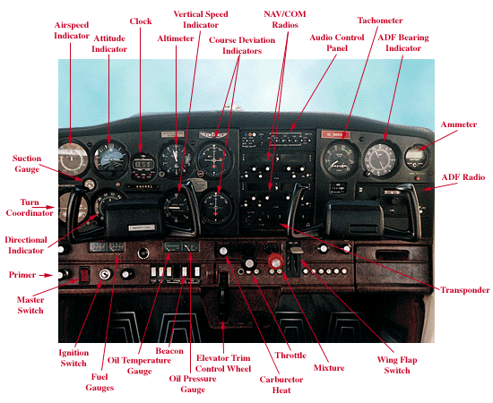
Instruments
(Requirement 2e)
Notes:
This is an instrument panel you might see in a small trainer airplane like a Cessna 172.

Slide 44
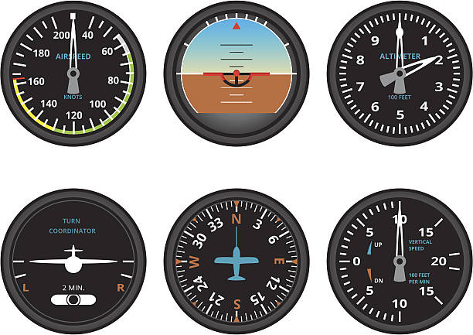
Instruments – 6 Pack
Airspeed Indicator
Displays speed the air is moving over the wings.
Attitude Indicator
Displays the attitude of the airplane (nose up, nose down, wings banked) in relation to the horizon.
Also called an Artificial Horizon.
(Requirement 2e)
Notes:
Airspeed: The airspeed indicator in the figure shows that the airplane is sitting still. Most modern aircraft use knots (nautical miles per hour) to measure speed. A nautical mile is 6,076 feet. Your family car uses statute miles per hour. A statute mile equals 5,280 feet.
Attitude: The attitude indicator in the figure is indicating level flight (nose and wings are level in relation to the horizon).

Slide 45
Instruments – 6 Pack
Altimeter
Displays the altitude of the airplane above mean sea level (MSL).
Turn Coordinator
Displays the rate at which a turn is being made.
Also called a Turn and Bank Indicator, or the Turn and Slip Indicator.
(Requirement 2e)
Notes:
Altimeter: This displays the altitude of the airplane above mean sea level (MSL) when properly adjusted to the current pressure setting. It can be changed for current altimeter (pressure) readings. This one is indicating 200 feet MSL.
Turn and Bank Indicator: The little airplane tips to show the airplane’s bank in relation to the horizon. The little black ball in the white bar at the bottom shows whether the airplane is coordinated, meaning the bank and yaw match for a stable turn. Pilots learn to “Step on the ball” to coordinate turns. The turn coordinator in the figure is indicating wings level and coordinated flight.

Slide 46
Instruments – 6 Pack
Heading Indicator
Displays the heading (direction) the airplane is flying.
Vertical Speed Indicator
Displays whether the airplane is in level flight, climbing, or descending, indicated in hundreds of feet per minute.
(Requirement 2e)
Notes:
Heading: The heading indicator in the figure is indicating a heading of north.
Vertical Speed: This one shows climbing at 1000 feet per minute.

Slide 47
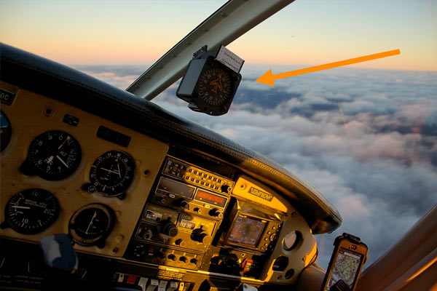
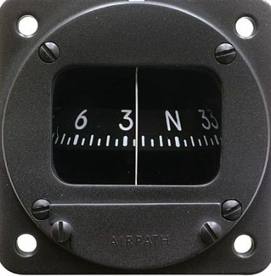
Instruments – Magnetic Compass
Required in Every Plane
(Requirement 2e)
Notes:
Why do you think it’s required?

Slide 48
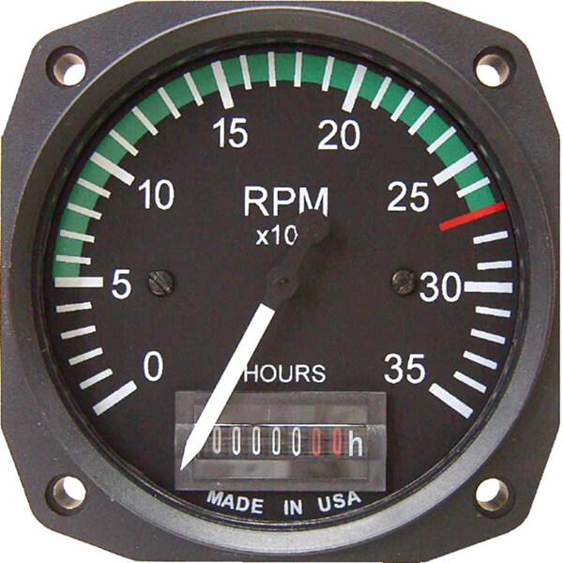
Instruments – Engine Gauges
Tachometer
Displays the engine speed in rpm.
Counts how many hours the engine has run since it was new.
(Requirement 2e)
Notes:
The tachometer shows how fast the motor is turning. When a pilot adds more power by pushing the throttle in, the tachometer shows that the motor is spinning faster. The tachometer in this figure shows that the engine is turned off.

Slide 49
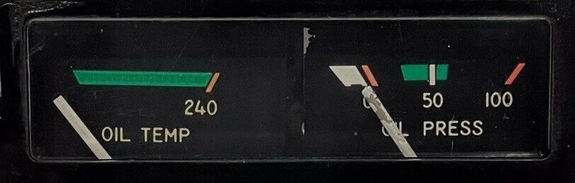
Instruments – Engine Gauges
Oil Pressure
Displays the pressure of the Engine oil.
Oil Temperature
Displays the temperature of the engine oil.
(Requirement 2e)
Notes:
These instruments help pilots know if the motor is running correctly. The instruments in this figure show that the engine is turned off.

Slide 50
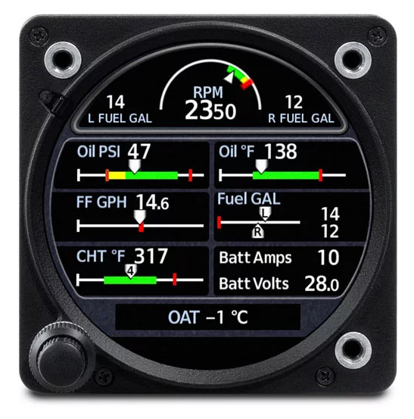
Instruments – Engine Gauges
Engine Monitor
Combines many gauges into one instrument. Often includes:
Tachometer
Oil Pressure
Oil Temperature
Fuel Levels
Battery Levels
(Requirement 2e)
Notes:
This instrument helps pilots know if the motor is running correctly. It is an electronic display that combines several different gauges.

Slide 51
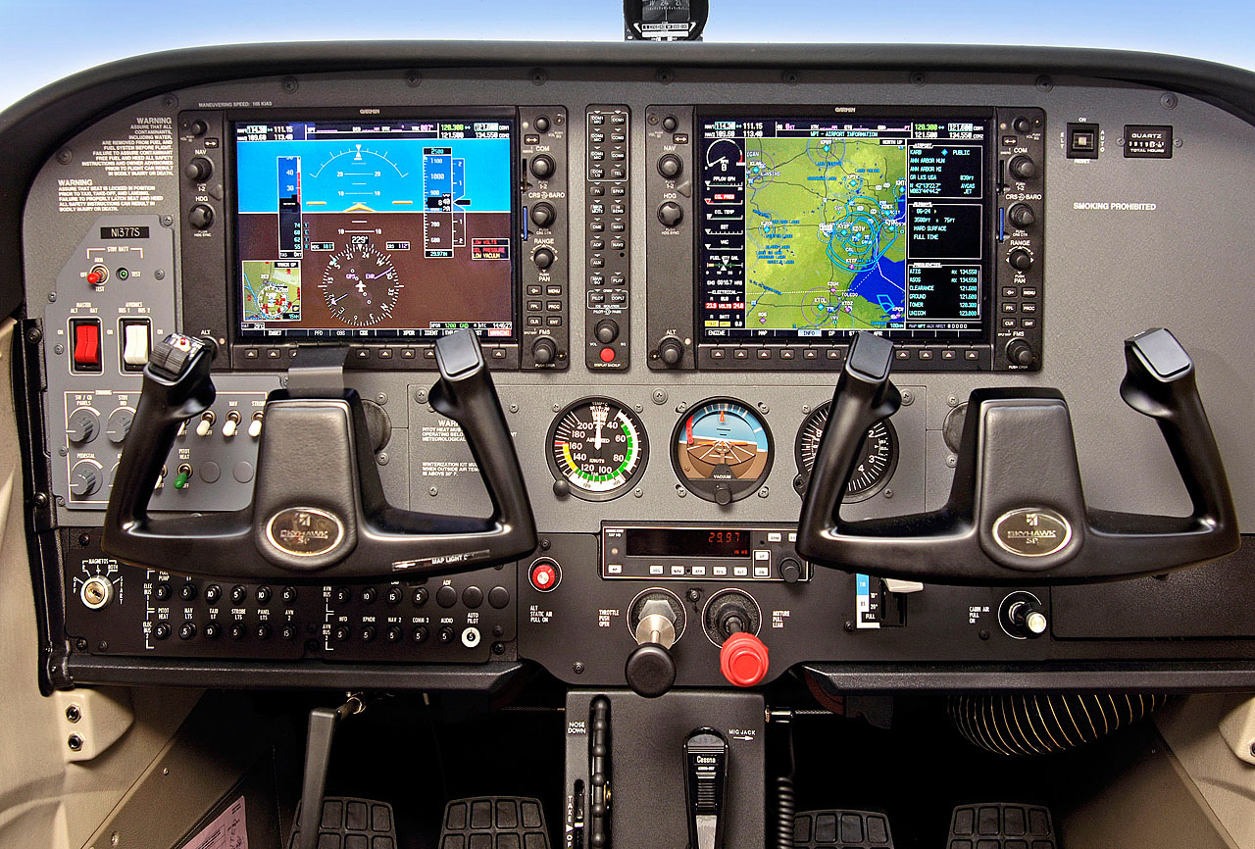
Instruments – Avionics
GPS Navigation
(Requirement 2e)
Notes:
Some aircraft have fancy avionics. A “glass cockpit” like this combines all the old-style instruments into one electronic display.
The airplane shown in this figure has GPS navigation. GPS units come in different sizes, from a glass cockpit like this to . . .

Slide 52

Instruments – Avionics
GPS Navigation
What does “GPS” stand for?
Global Positioning System
Satellite-based navigation
(Requirement 2e)
Notes:
. . . to much smaller.
GPS is the most common type of instrument navigation today
What is GPS? How does it work? Where else do you use GPS?

Slide 53


Instruments – Avionics
GPS Navigation
Global Positioning System
Satellite-based navigation
VOR Navigation
Very High Frequency Omni-Directional Range
Ground-based navigation
(Requirement 2e)
Notes:
Another type of instrument navigation system is called VOR. You won’t see VOR in your car or on your phone.

Slide 54

Instruments – Avionics
Radios (Nav/Com)
(Requirement 2e)
Notes:
Almost all aircraft have at least one radio so the pilot can talk to air traffic control and other pilots.

Slide 55

Instruments – Avionics
Radios (Nav/Com)
Some are just radio (com)
Some work with the GPS or VOR (nav/com)
(Requirement 2e)
Notes:
It’s common to have two radios.
Some radios are just “com” radios, for communication only.
Some are “nav/com” radios, for navigation and communication. Nav/coms read VOR signals.

Slide 56

FPG Glider
(Requirement 3b)
Notes:
We are going to make and test FPG gliders.

Slide 57
Requirement 4
Do ONE of the following:
Visit an airport. After the visit, report on how the facilities are used, how runways are numbered, and how runways are determined to be "active."
Visit a Federal Aviation Administration facility control tower, terminal radar control facility, air route traffic control center, or Flight Standards District Office. (Phone directory listings are under U.S. Government Offices, Transportation Department, Federal Aviation Administration. Call in advance.) Report on the operation and your impressions of the facility.
Visit an aviation museum or attend an air show. Report on your impressions of the museum or show.
(Requirement 4)
Notes:
Have you done any of these things? Report on your activity to your merit badge counselor. Young Eagles

Slide 58
Types of Pilot Certificates
Sport
Cannot carry more than one passenger, authorized to fly only light-sport aircraft during the daytime only
Recreational
May fly aircraft of up to 180 horsepower (130 kW) and 4 seats in the daytime for pleasure only
Private
May fly for pleasure or personal business. Private pilots cannot be paid, compensated to fly, or hired by any operator.
Instrument Rating
An add-on to the private pilot certificate that allows the pilot to fly in limited visibility conditions
(Requirement 1e)
Notes:
There are different kinds of pilot certificates and ratings.

Slide 59
Job Opportunities
Careers with the Airlines (ATP)
General Aviation (Corporate, Charter, CFI)
Airports
Aircraft Maintenance (A&P)
Aerospace Industries, Engineering Research & Development
Government Aviation (FAA, NOAA)
Military Aerospace (USAF, USN, USMC, USA)
National Aeronautics & Space Administration (NASA)
(Requirement 5)
Notes:
Careers with the airlines:
Pilot, MX technician, reservation sales agent, flight attendant, and avionics technician
Landing Facilities
Airport manager, other airport careers (firefighter, security, emergency services, mx workers, skycaps, clerks, restaurant workers, concessionaire employees), fixed base operator
Engineering Research & Development
R & D specialist
General Aviation
Business flying, executive flying, commercial aviation (air taxi/charter operator, rental use, aerial applications{crop dusting}), personal aviation, instructional flying, airplane sales
Government Aviation
Federal aviation administration (FAA), air traffic controller, FAA operations and mx inspection, engineering and testing, civil aviation security specialist
Aerospace Industries
Manufacturing of major carrier A/C (Boeing, McDonnell Douglas, Lockheed), general aviation manufacturing (Cessna, Learjet, Beech, Gulfstream, Piper), A/C engine manufactures, military and space manufacturing
Military Aerospace
USAF, USN, USMC, USA, National oceanic & atmospheric administration (NOAA)
NASA
- Space sciences, life sciences, fluid and flight mechanics, materials and structures, propulsion systems, flight systems, measurement and instrumentation, data systems, experimental facilities, equipment and operations, administration and management

