Slide 1
Wind Racing
Aerodynamics – Thrust & Drag

Slide 2
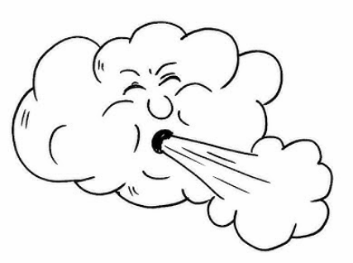
What kinds of objects are moved by wind?
Notes:
Ask: What kinds of objects are moved by wind? List the participants’ answers on a white board. Then compare the participants’ list with the photos on the following slides. Ask: Did we list the same things?

Slide 3

What kinds of objects are moved by wind?
Notes:
Ask: Did we list the same things?

Slide 4
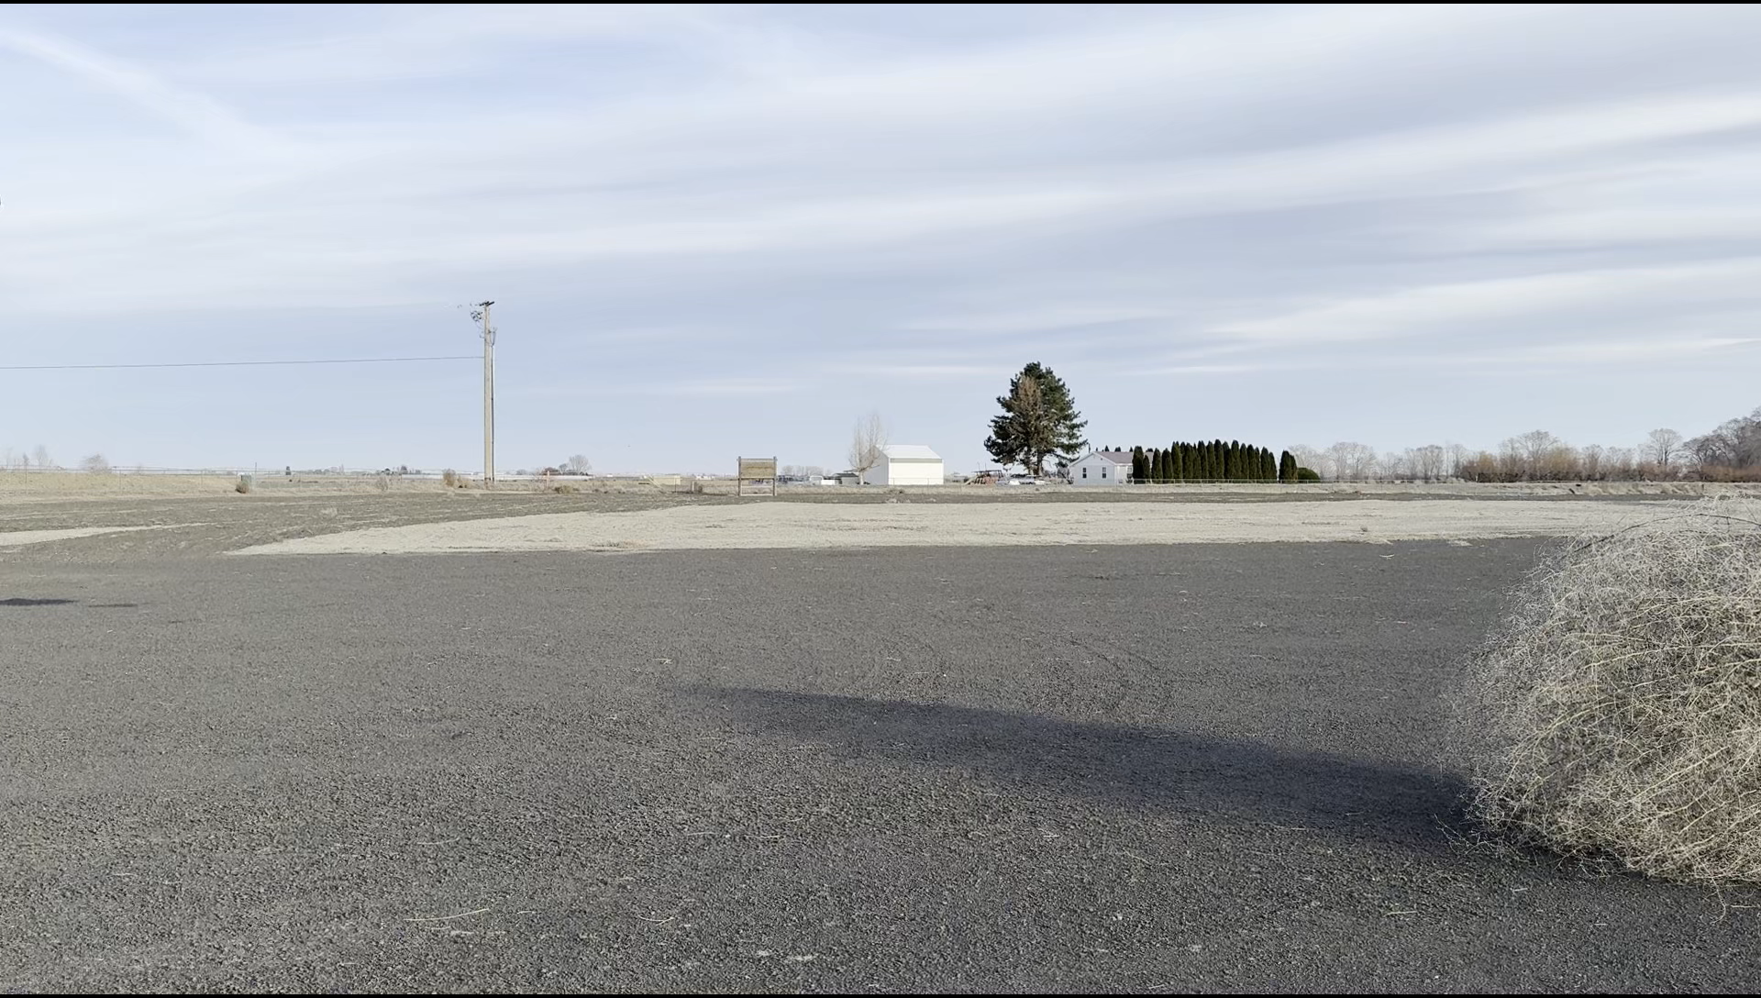
What kinds of objects are moved by wind?
Notes:
Ask: Did we list the same things?

Slide 5
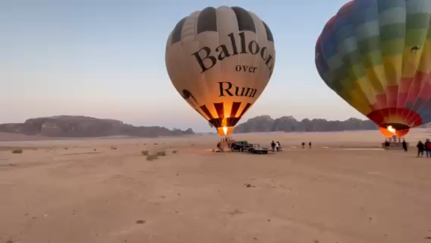
What kinds of objects are moved by wind?
Notes:
Ask: Did we list the same things?

Slide 6
What kinds of objects are moved by wind?
Notes:
Ask: Did we list the same things?

Slide 7
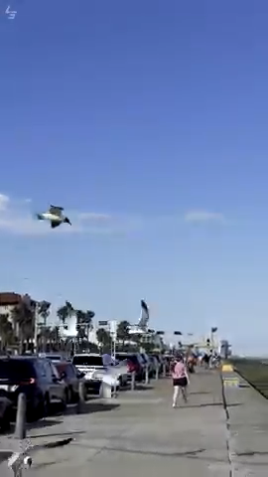
What kinds of objects are moved by wind?
Notes:
Ask: Did we list the same things?

Slide 8
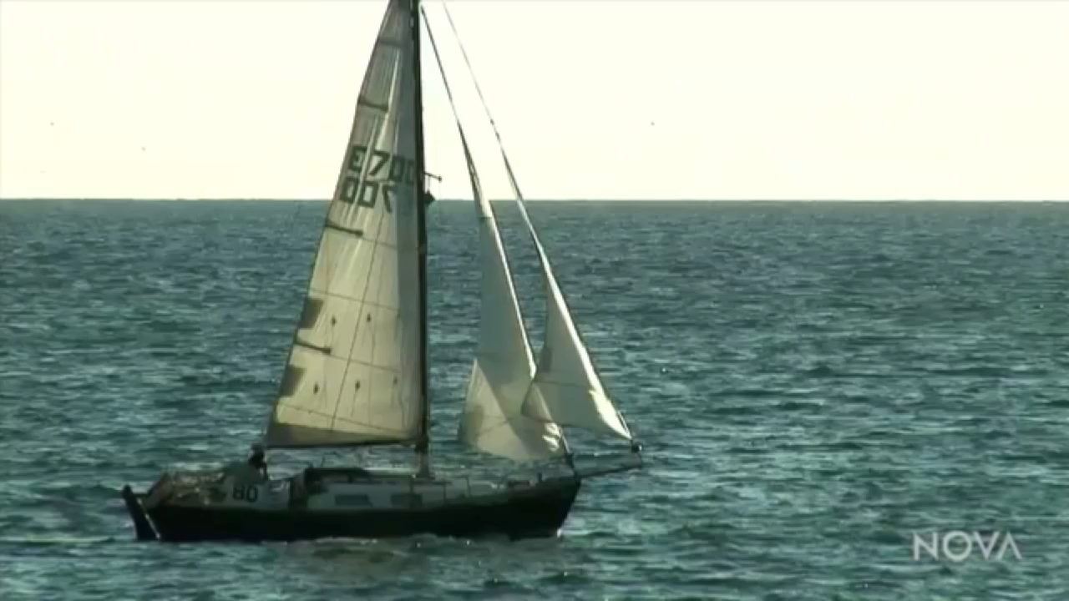
What kinds of objects are moved by wind?
Notes:
Ask: Did we list the same things?

Slide 9
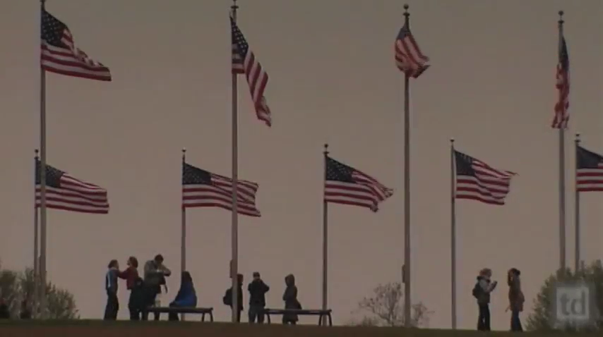
What kinds of objects are moved by wind?
Notes:
Ask: Did we list the same things?

Slide 10
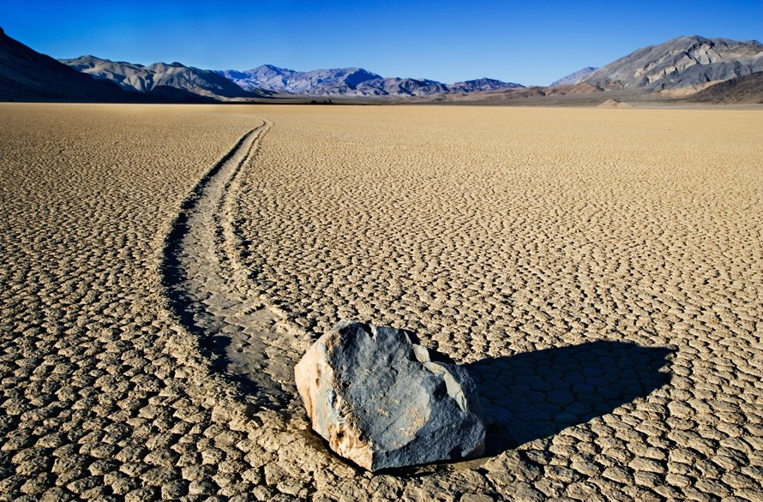
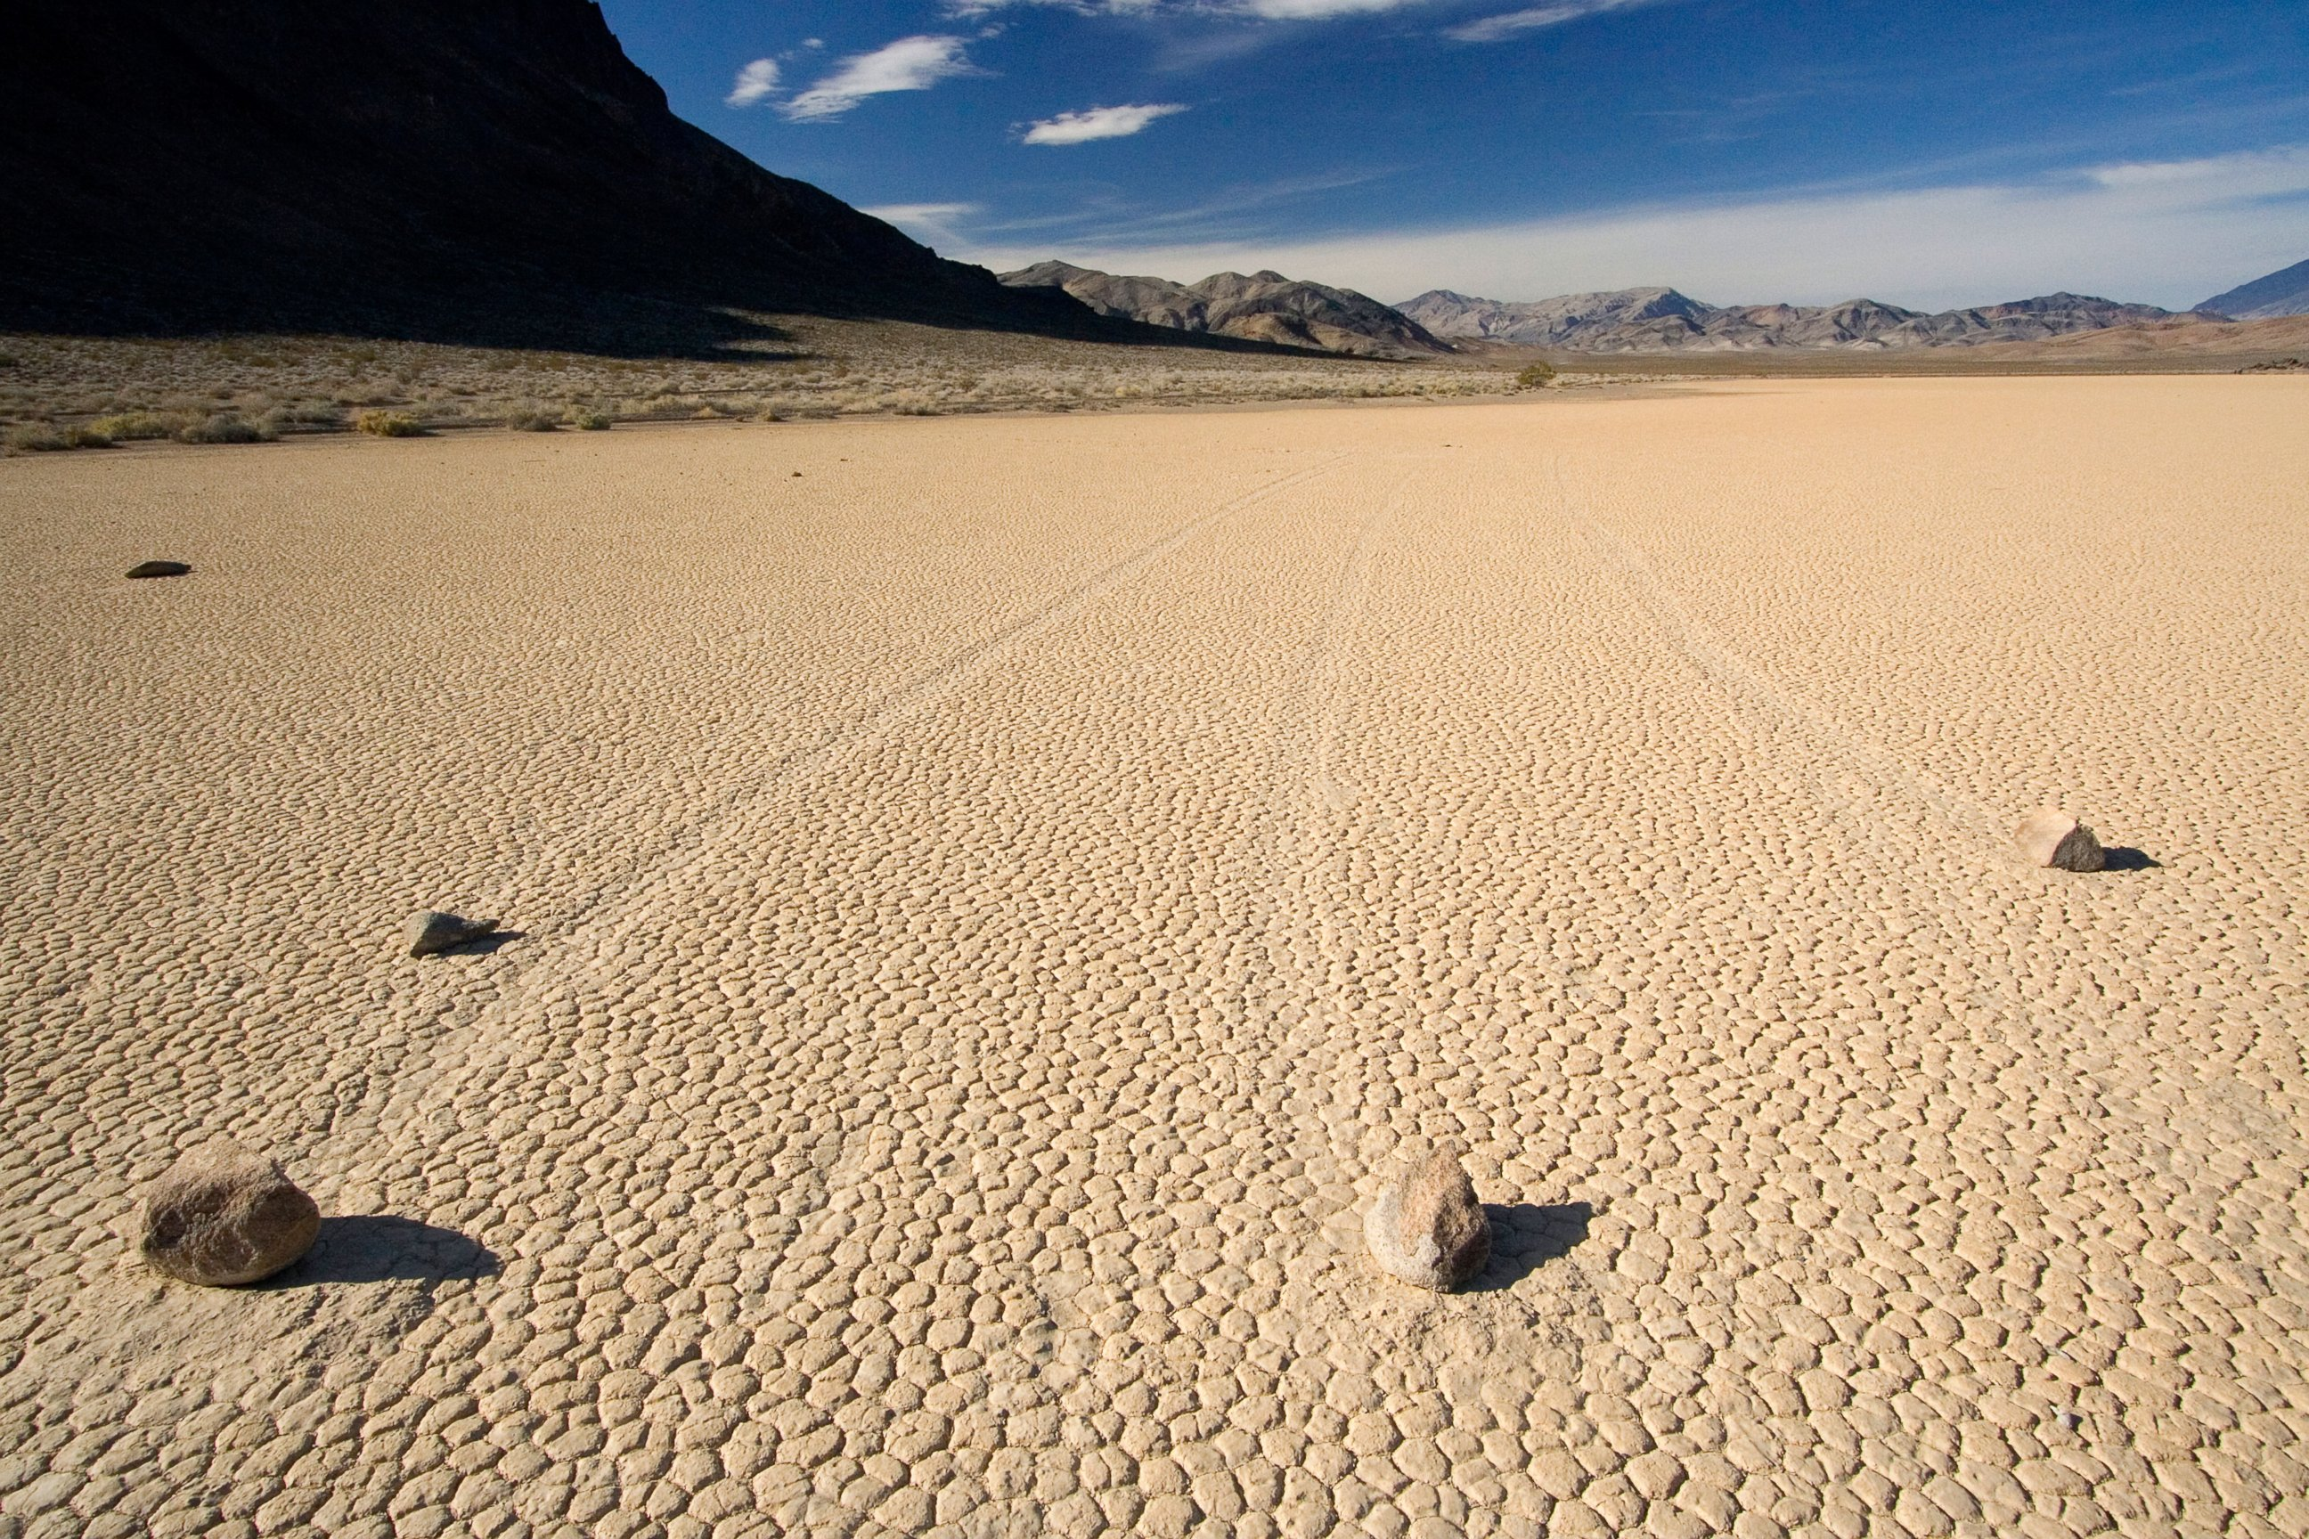
What kinds of objects are moved by wind?
Notes:
Ask: Did you know the wind can move rocks? These rocks are in Death Valley in California. Researchers were stumped for a long time trying to figure out how these rocks seemed to move by themselves. There were no footprints near them. Finally, the researchers observed the wind slowly pushing the rocks forward when rain or dew made the ground muddy and slimy.

Slide 11
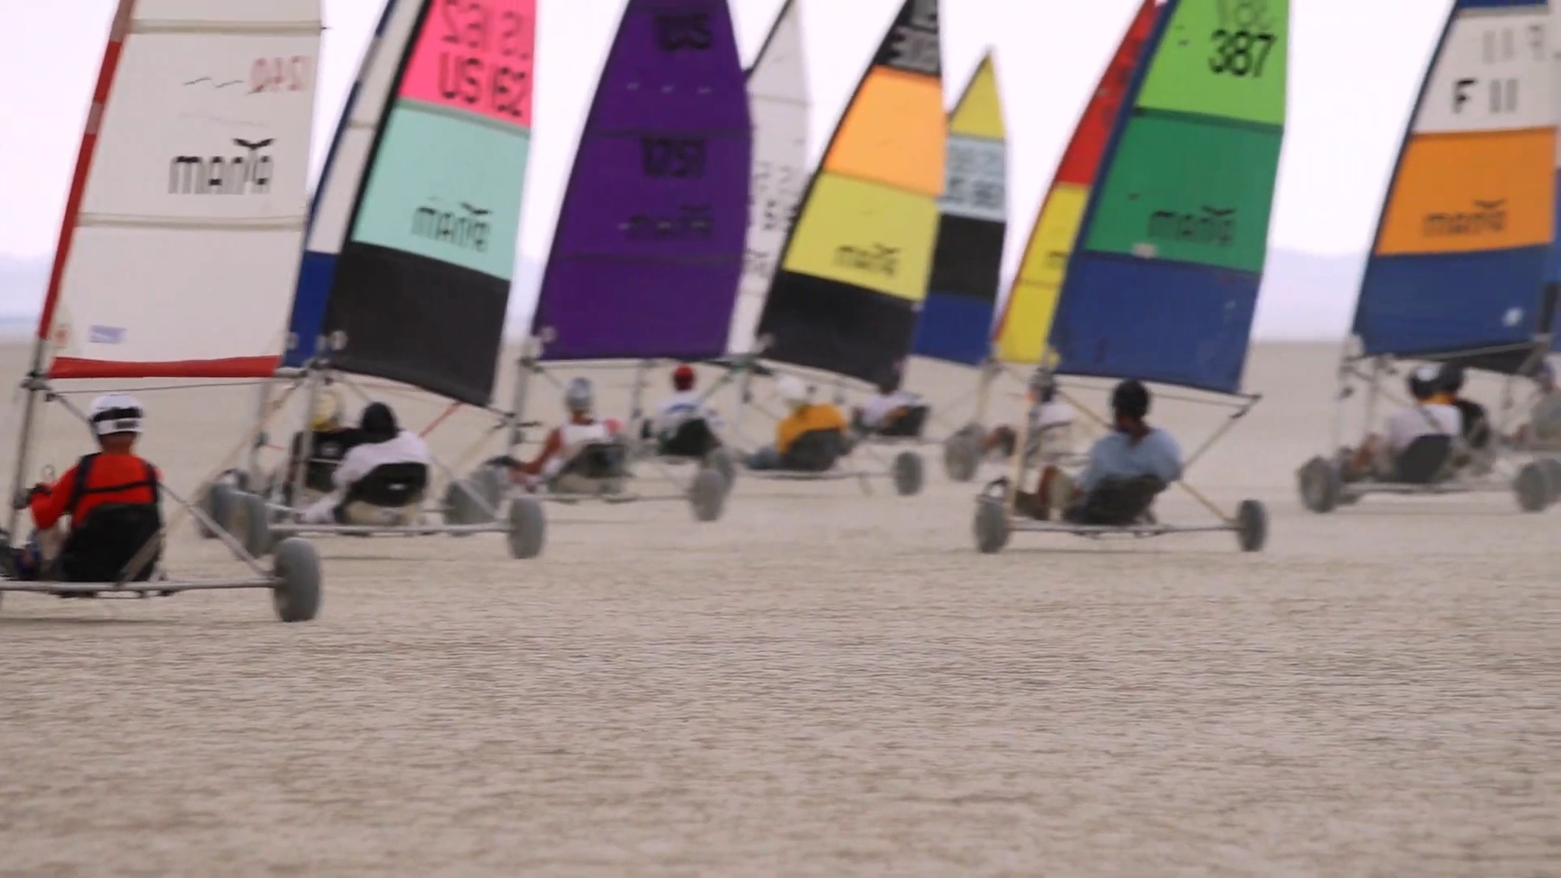
What kinds of objects are moved by wind?
Notes:
These are land wind racers. They are like sailboats, but they have wheels to move on the land.

Slide 12
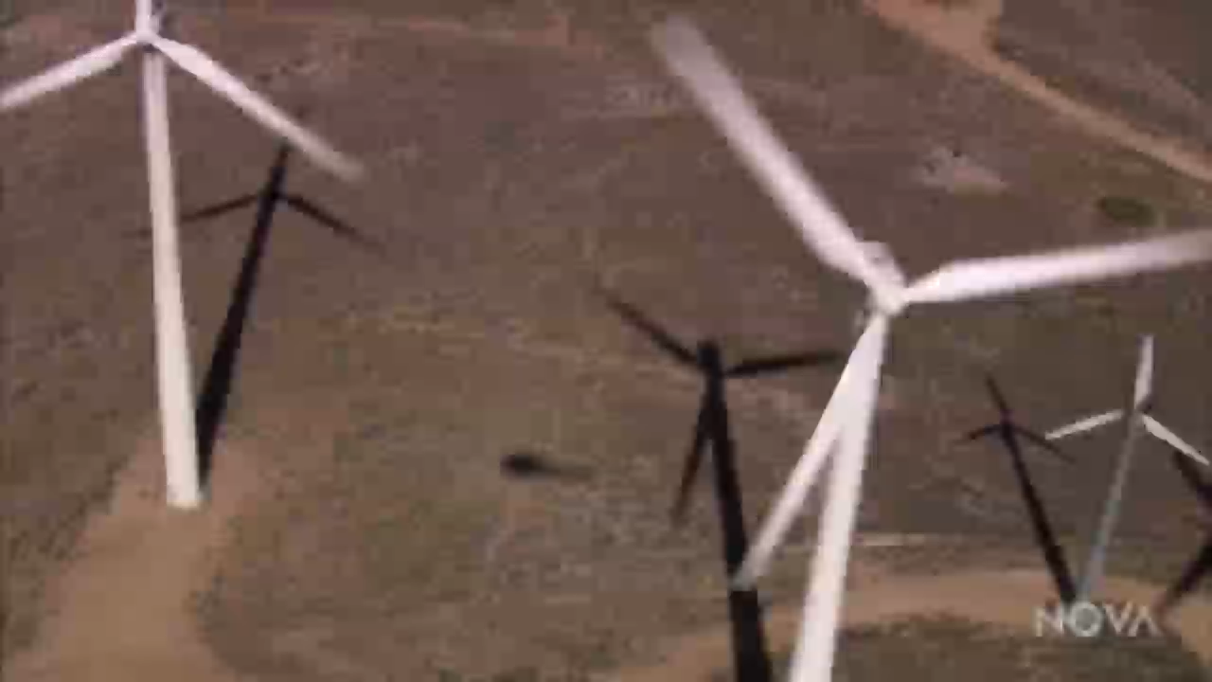
How does the wind make things move?
Wind is energy

Slide 13
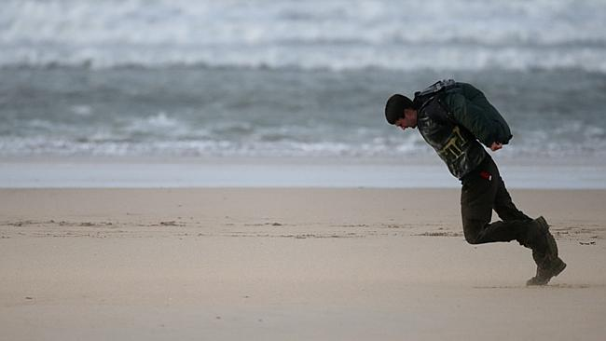
How does the wind make things move?
Wind is energy
It’s harder to walk
against the wind –
it takes more of
your energy
Notes:
Walking into the wind is harder – it takes more of your energy

Slide 14
How does the wind make things move?
Wind is energy
Walking with the
wind is easier –
you can use some
of its energy to
move you forward
Notes:
Walking with the wind is easier – you can use some of its energy to move you forward

Slide 15
How does the wind make things move?
We capture the wind’s energy to make things move.
The more energy we capture,
the more power it will give us.

Slide 16
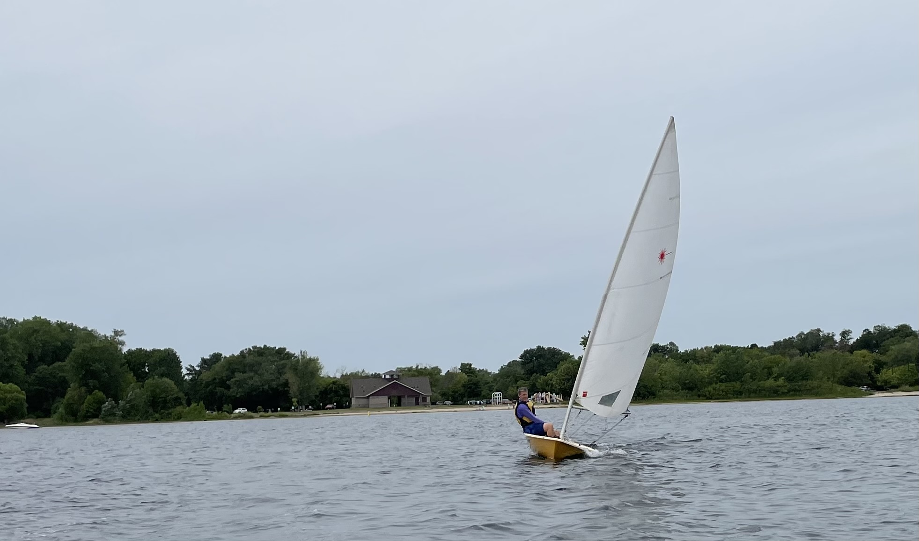
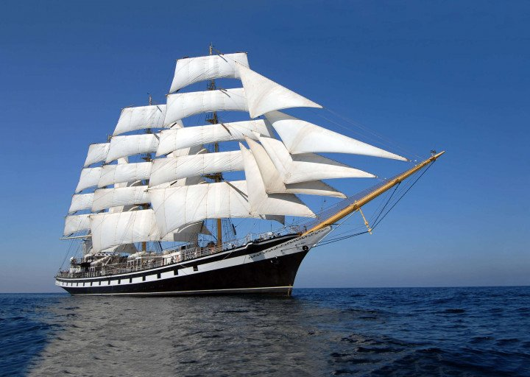
How does the wind make things move?
Notes:
Ask: Which ship do you think will capture more energy?

Slide 17
How does the wind make things move?
Energy to move forward = thrust
Thrust
Notes:
The energy that moves the sailboat forward is called thrust.
Ask: Is there anything holding the boat back? (Answer: It has to push through the water.)

Slide 18
How does the wind make things move?
Resistance to moving forward = drag
Drag
Notes:
Drag is resistance to forward movement.

Slide 19
How does the wind make things move?
How do we move forward?
Thrust
Drag
Notes:
For something to move forward, thrust has to be greater than drag.

Slide 20
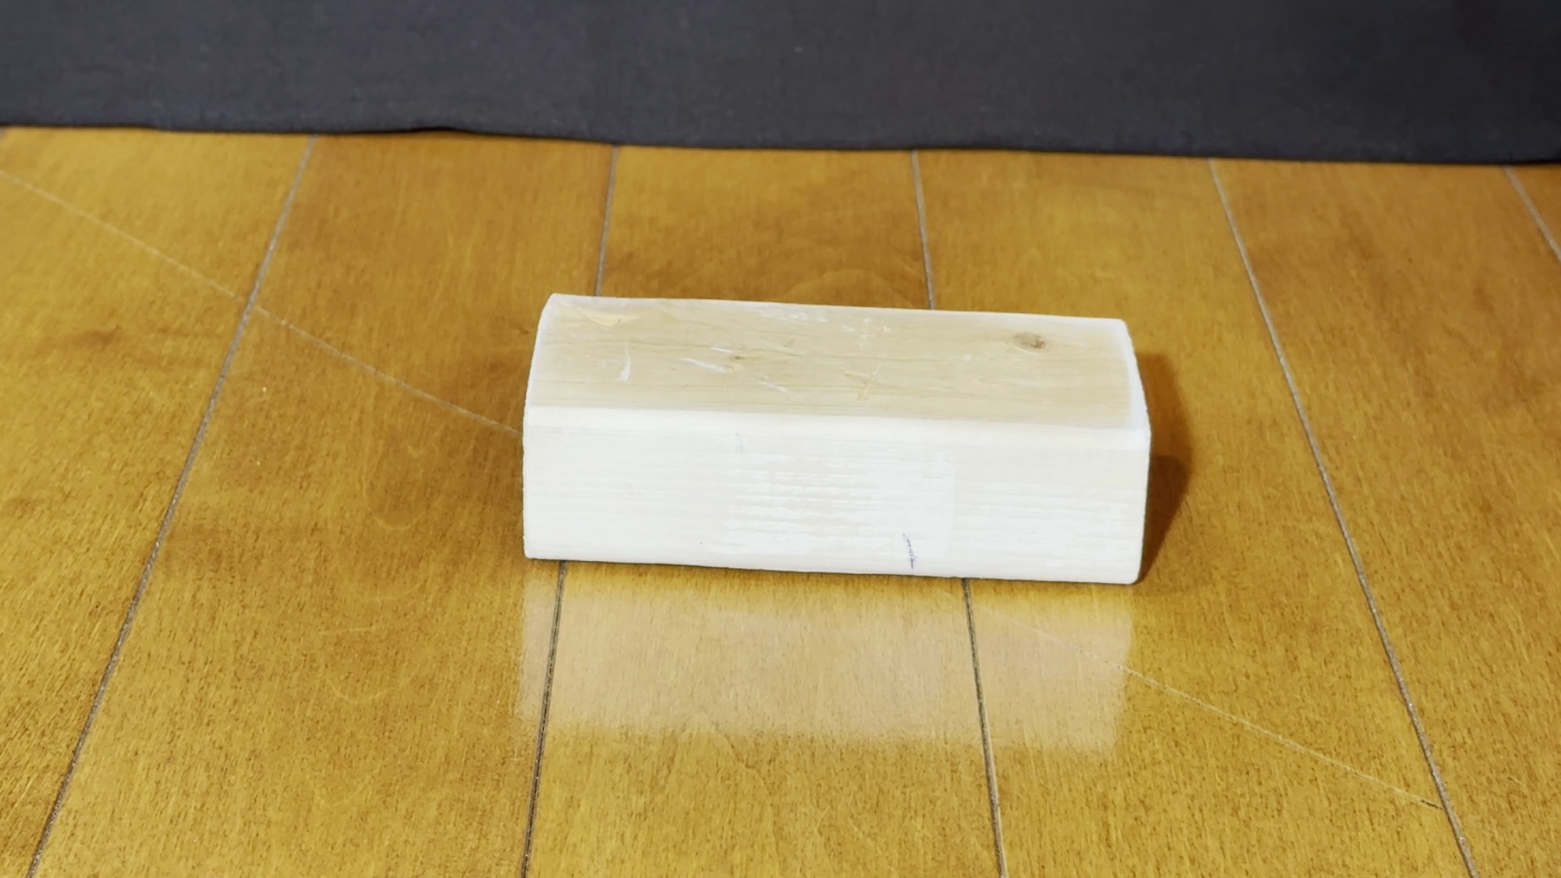
Can I move the block with wind?
Notes:
Ask: What would it take for the wind to move this block of wood? Do you think it will work?
Now you try. Can you blow hard enough?

Slide 21
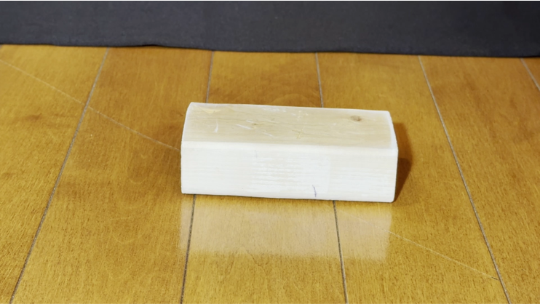
Can I move the block with wind?
Thrust
Drag
Notes:
Ask: What would it take for the wind to move this block of wood? Do you think it will work?
Now you try. Can you blow hard enough?

Slide 22
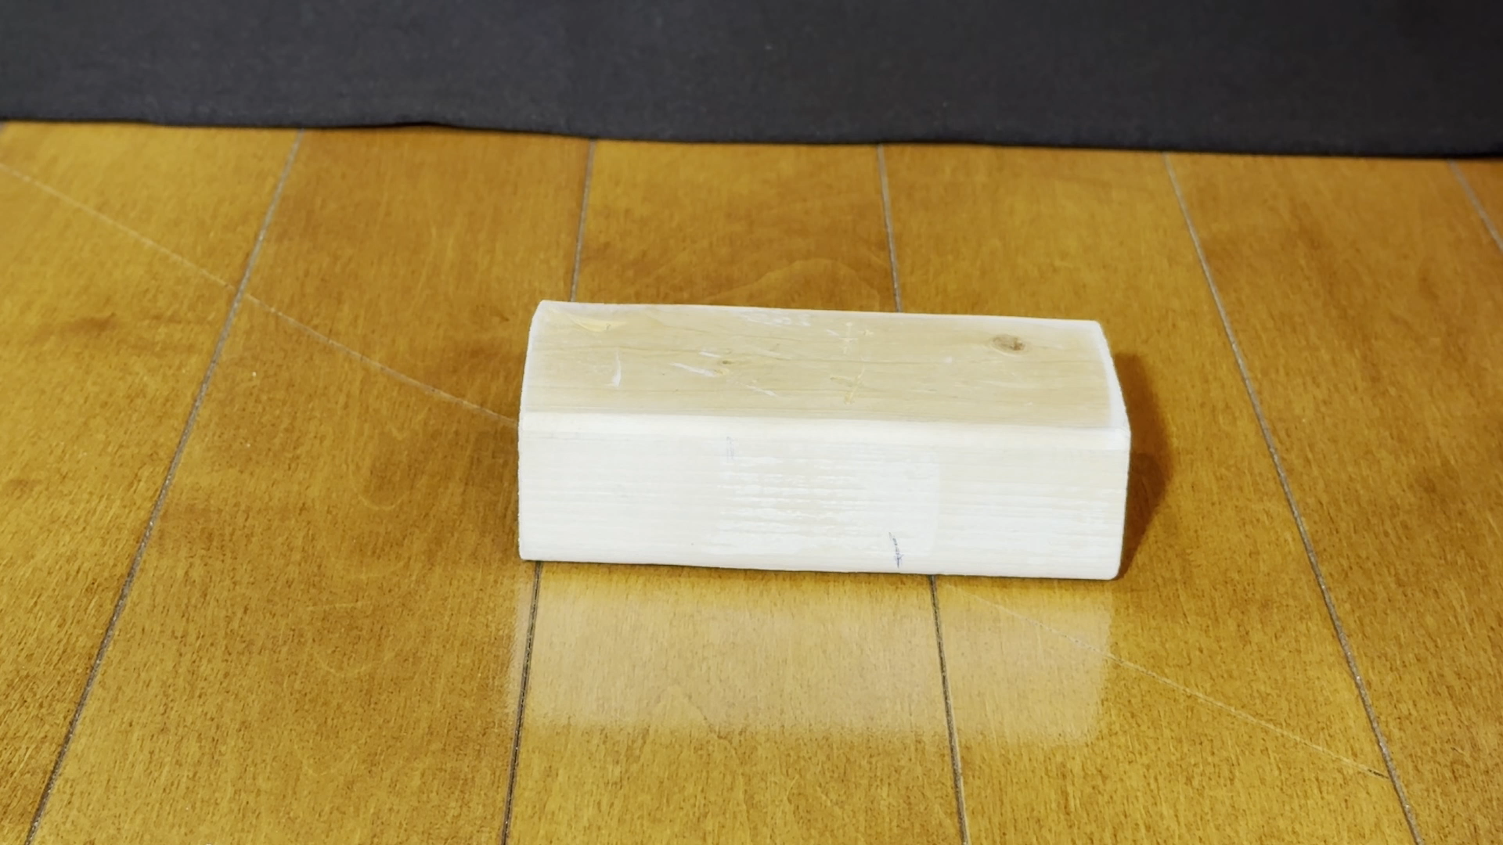
Can I move the block with wind?
Notes:
Ask: What could we change to move the block? Let’s try adding more thrust. Maybe the wind isn’t enough.
Now you try pushing it. What do you think it takes more thrust to move the block? (Answer: When you push it, there’s enough thrust to overcome drag.)
Ask: How could we get it to move using wind power? (Answer: We could reduce drag.)
Let’s try reducing drag. The block is dragging against the floor. How can we reduce the drag?

Slide 23
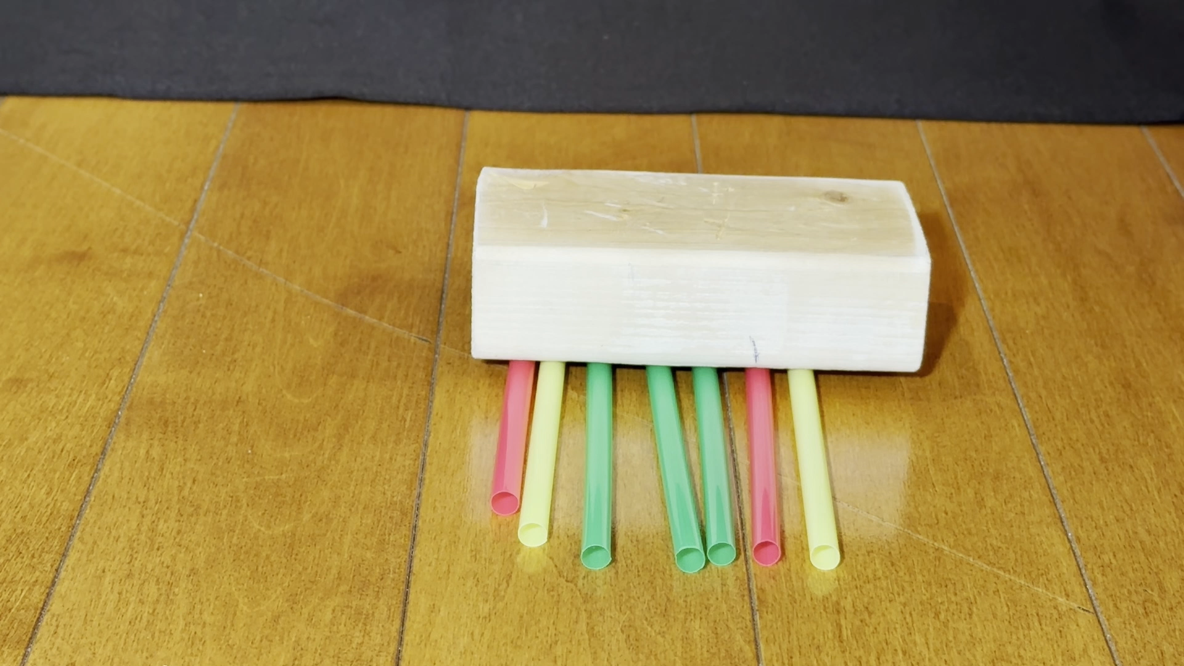
Can I move the block with wind?
Notes:
Ask: Do you think these straws will reduce drag enough for the wind to move the block?
Now you try it.

Slide 24
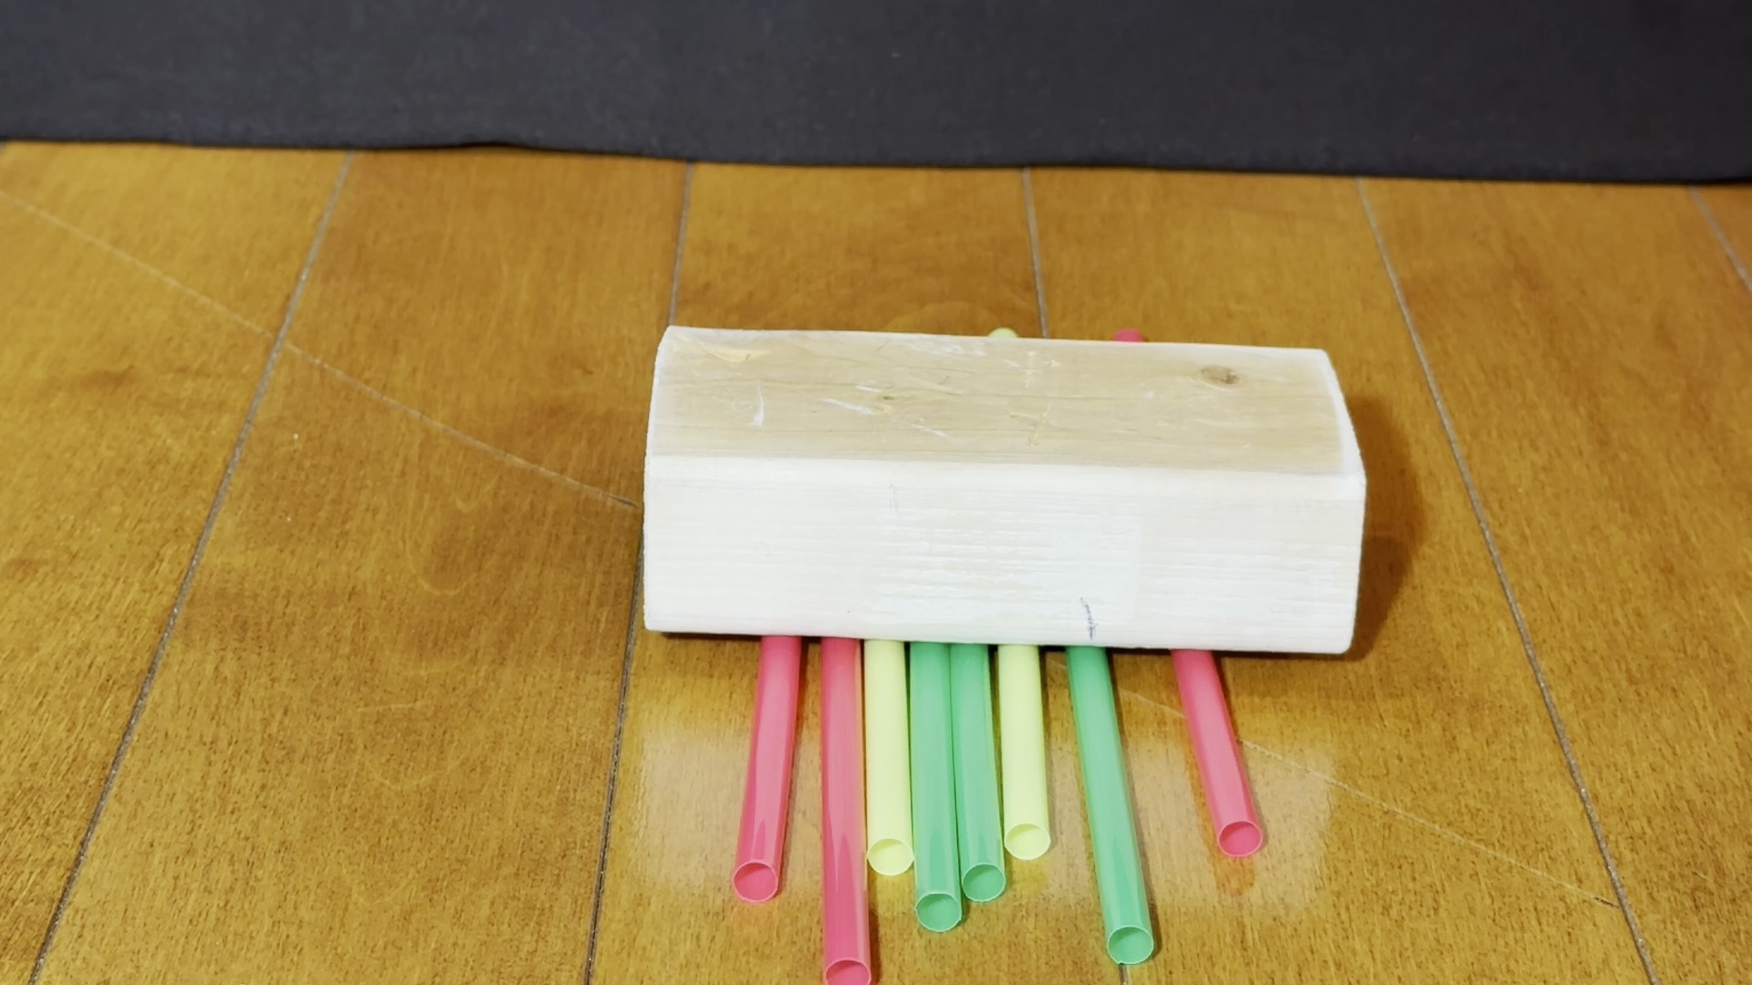
Can I move the block with wind?
Notes:
Ask: What do you think will happen if we reduce drag AND increase thrust?
Now you try it.

Slide 25
How can we capture the wind’s energy?
Notes:
Ask: What could we do to really capture the wind’s energy for thrust? (Answer: Add a sail.)

Slide 26
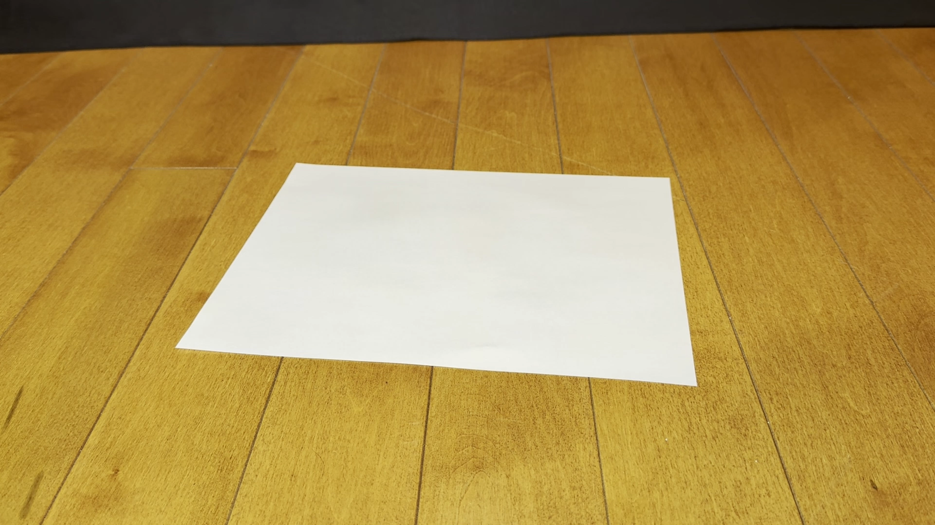
What kind of sail works best?
Notes:
Show three sheets of paper, one flat, one with a short sail, and one with a taller sail. Ask: Which sail do you think will work best? Demonstrate by blowing on the three sails.
The flat paper doesn’t really have a sail, so it can’t capture the wind’s energy for thrust. It also has the most drag.

Slide 27
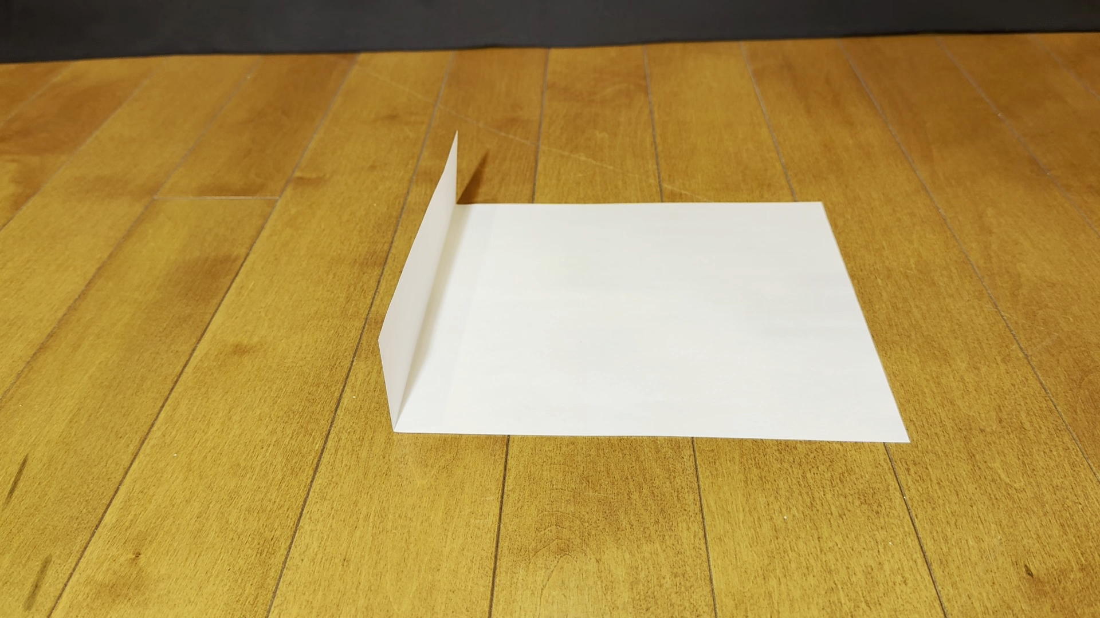
What kind of sail works best?
Notes:
Show three sheets of paper, one flat, one with a short sail, and one with a taller sail. Ask: Which sail do you think will work best? Demonstrate by blowing on the three sails.
The short sail captures some of the wind’s energy for thrust, and it has less drag against the floor.

Slide 28
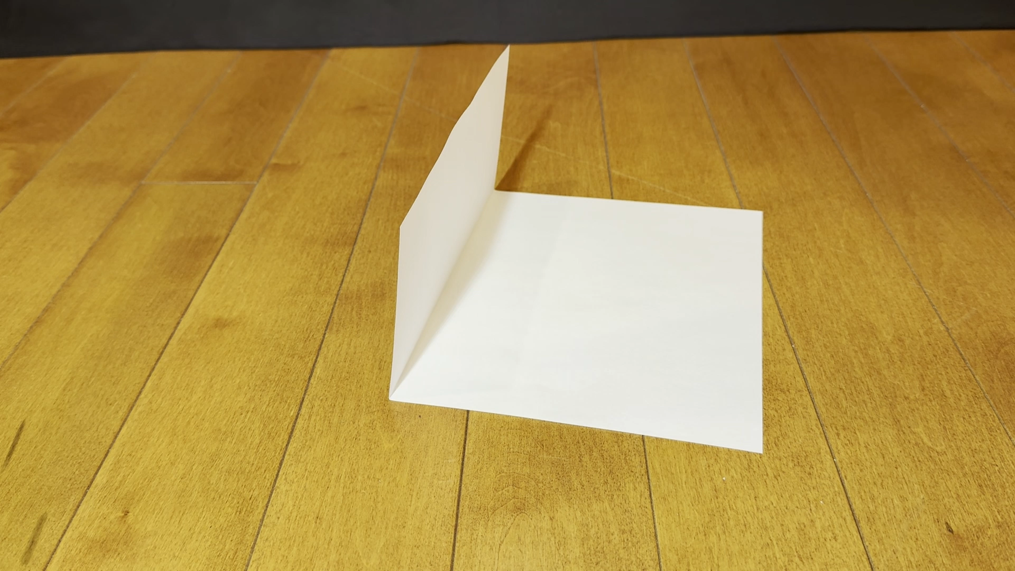
What kind of sail works best?
Notes:
Show three sheets of paper, one flat, one with a short sail, and one with a taller sail. Ask: Which sail do you think will work best? Demonstrate by blowing on the three sails.
The tall sail captures even more of the wind’s energy for thrust, and has the least drag against the floor.

Slide 29
Vehicles that use the wind for power
Notes:
Ask: What kinds of vehicles are powered by the wind?

Slide 30
Vehicles that use the wind for power
Notes:
Ask: What kinds of vehicles are powered by the wind?

Slide 31
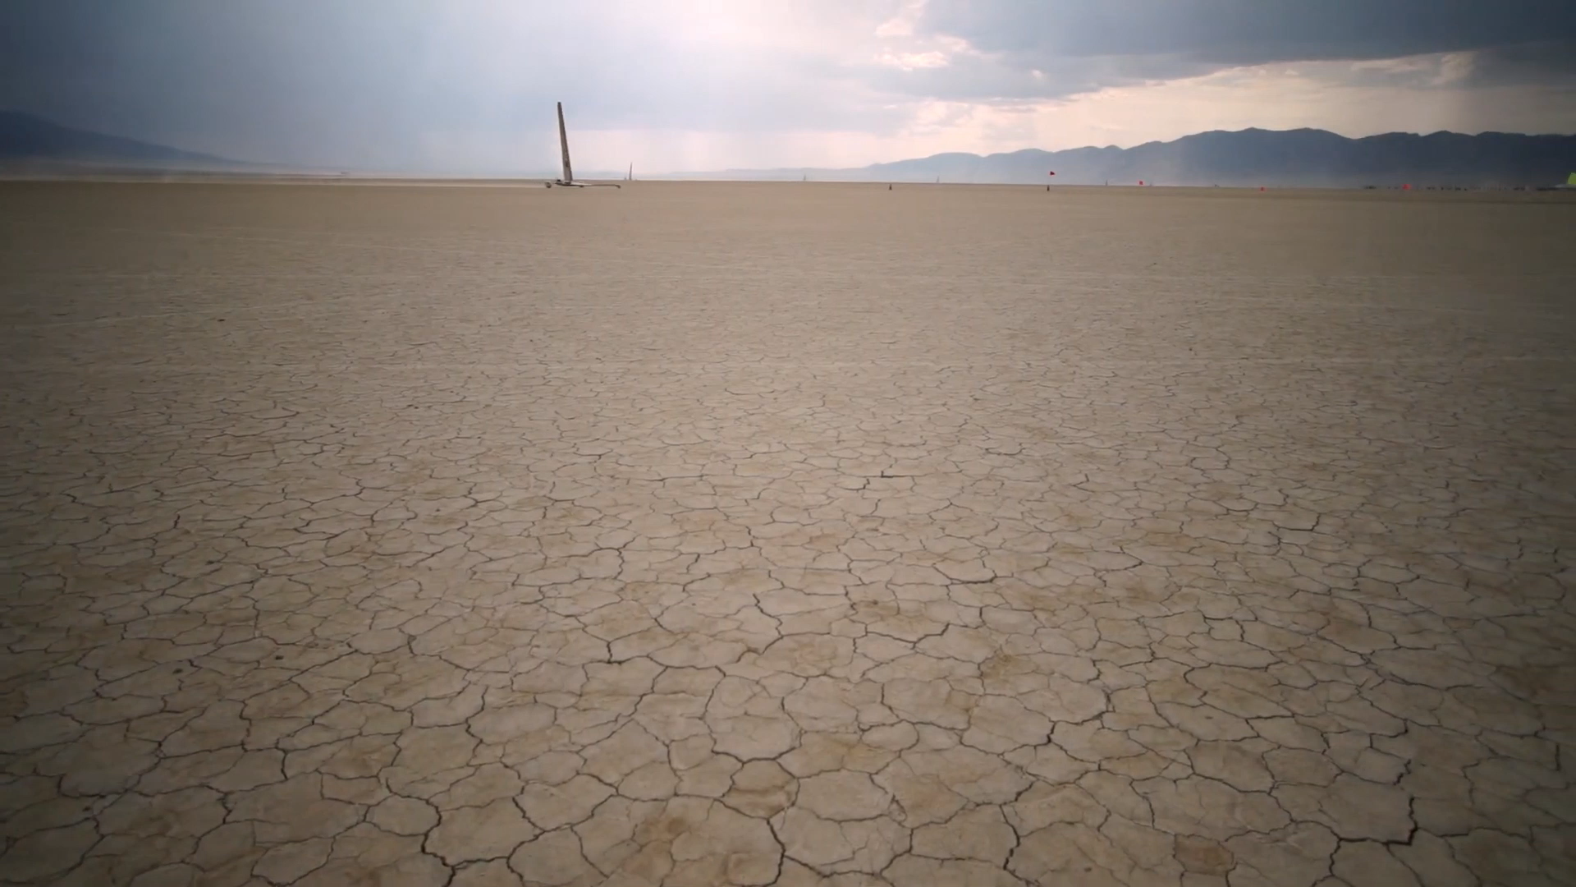
Vehicles that use the wind for power
Notes:
Land sailing and sailboat racing both use wind to power the racers and competitive sports. Engineers understand how to harness the wind and reduce drag to get the most energy (thrust) out of the wind’s energy.

Slide 32
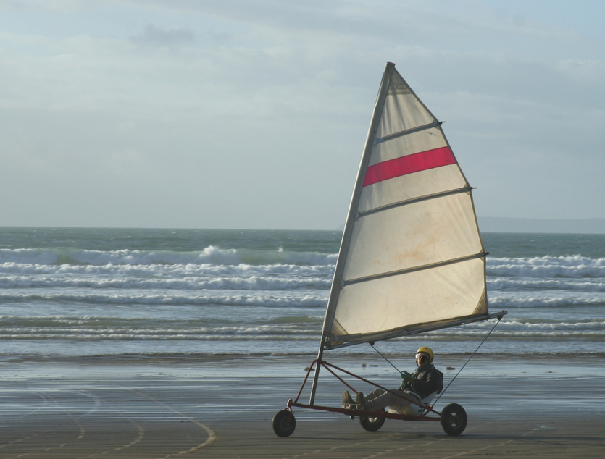
Engineering Challenge:
Build a Wind Racer
Let’s build a Wind Racer!
Notes:
Today you will be an engineer that builds a wind racer. You need to build a racer that moves across the track using only wind as the source of power. You will get to test your vehicle to see how successfully it races.
STOP on this slide if the group will design their own racers. Help the group consider how they can reduce drag, and how they can capture the wind’s energy.
If they are using the template and following the instructions to build a racer, continue to the next slide

Slide 33
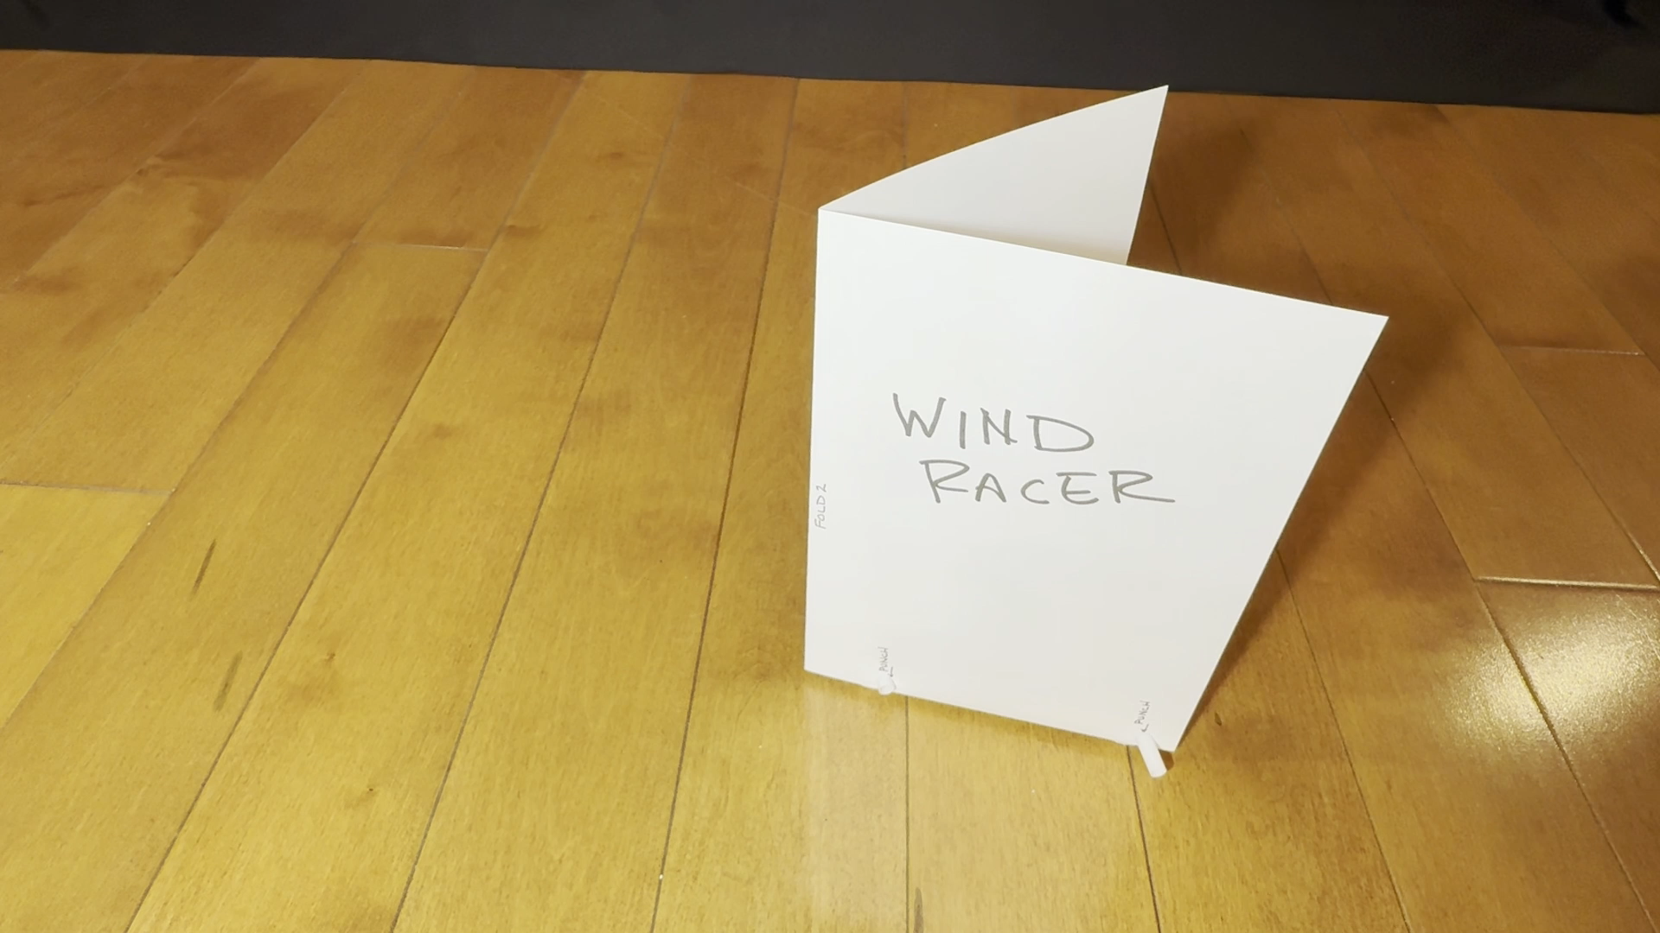
Engineering Challenge:
Build a Wind Racer
Notes:
This is what your wind racer will look like when it’s done.

Slide 34
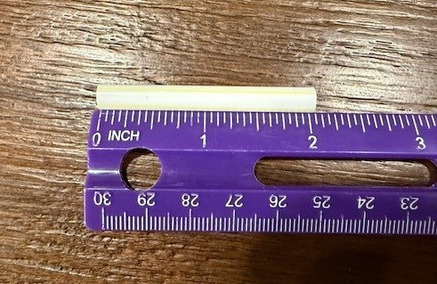
Engineering Challenge:
Build a Wind Racer – Step 1
Notes:
Cut a 2 inch piece off the straw.

Slide 35
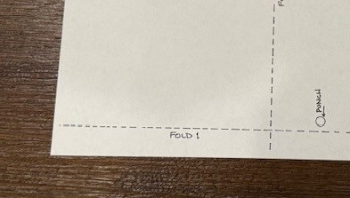
Engineering Challenge:
Build a Wind Racer – Step 2
Notes:
Fold 1

Slide 36
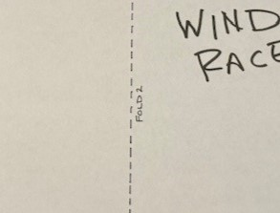
Engineering Challenge:
Build a Wind Racer – Step 3
Notes:
Fold 2

Slide 37
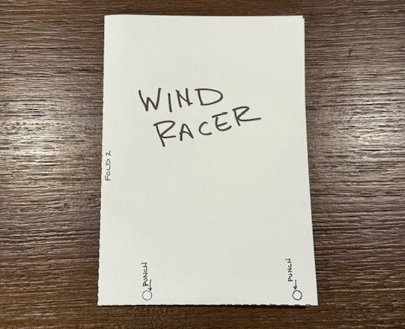
Engineering Challenge:
Build a Wind Racer – after Step 3
Notes:
After step 3, it should look like this.

Slide 38
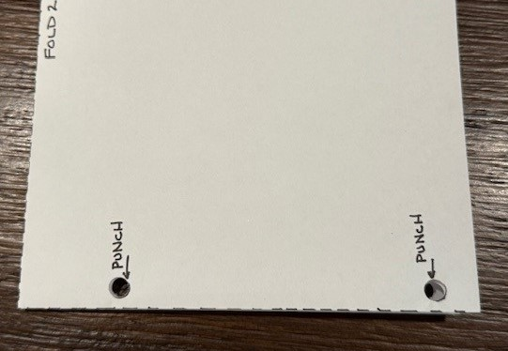
Engineering Challenge:
Build a Wind Racer – Step 4
Notes:
Punch holes

Slide 39
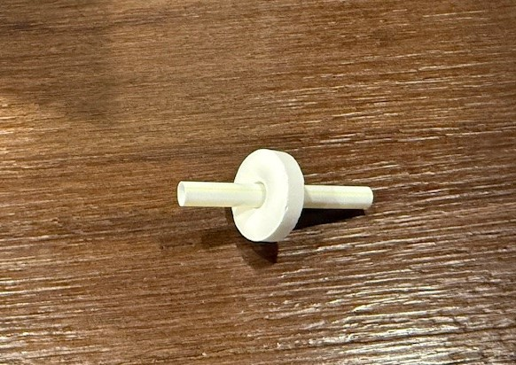
Engineering Challenge:
Build a Wind Racer – Step 5
Notes:
Put a candy on the short straw

Slide 40
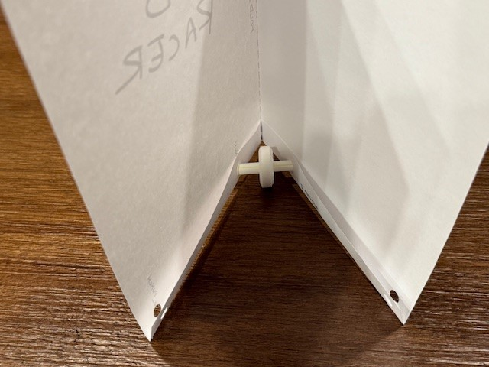
Engineering Challenge:
Build a Wind Racer – Step 6
Notes:
Poke the straw through the holes near fold 2. The candy will be inside the folded paper.

Slide 41
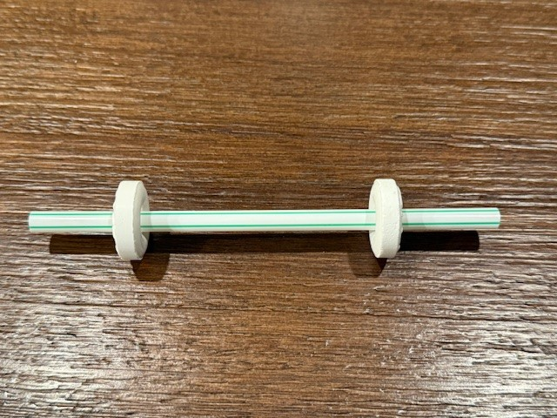
Engineering Challenge:
Build a Wind Racer – Step 7
Notes:
Put two candies on the long straw.

Slide 42
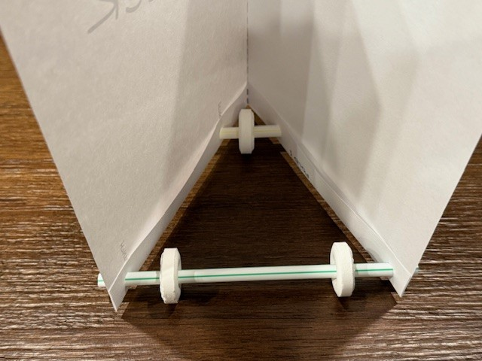
Engineering Challenge:
Build a Wind Racer – Step 8
Notes:
Poke the ends of the straw through the two holes away from Fold 2.

Slide 43
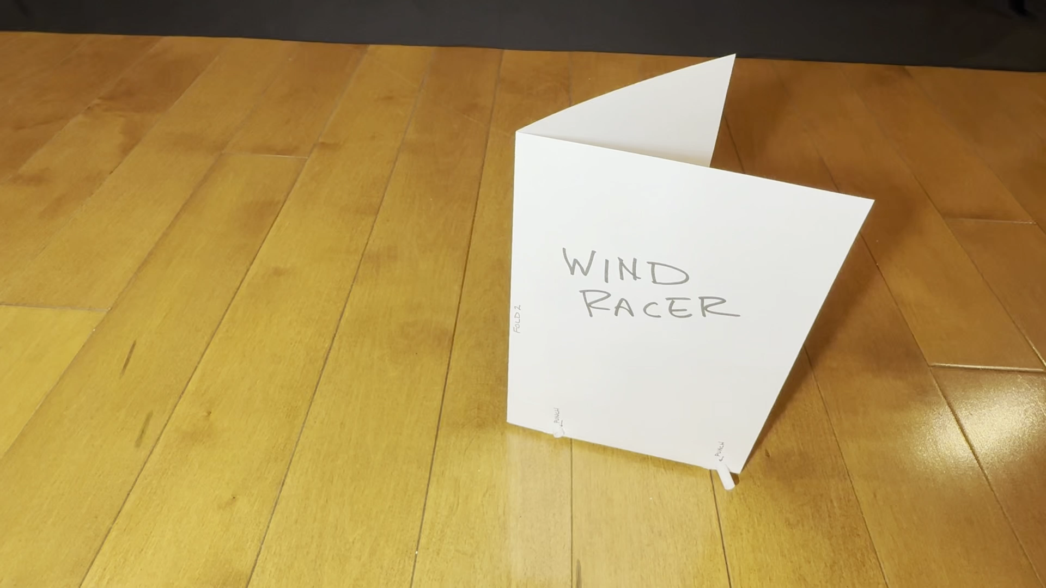
Engineering Challenge:
Build a Wind Racer
Notes:
This is what the racer will look like when it’s done.

