Slide 1
Wind Racing
Aerodynamics – Thrust & Drag

Slide 2
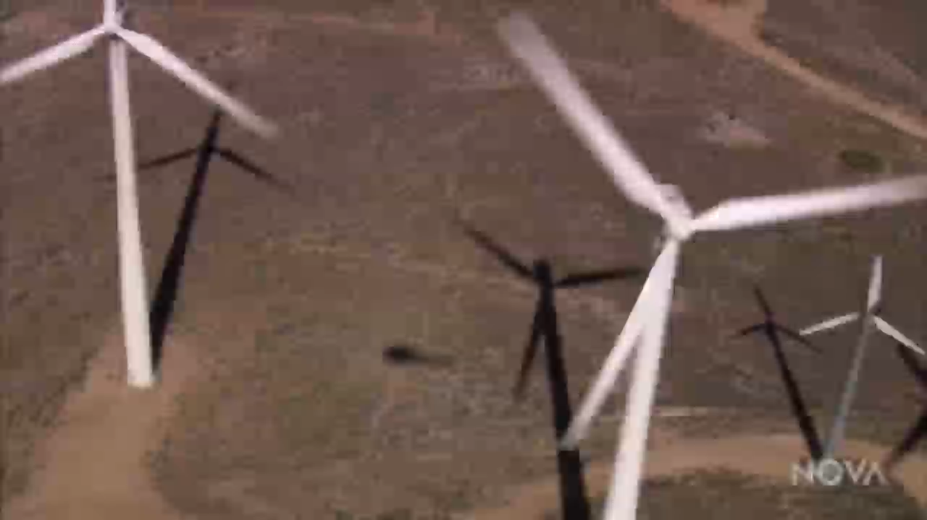
Wind is energy
Wind is a type of kinetic energy
Kinetic energy is motion energy.

Slide 3
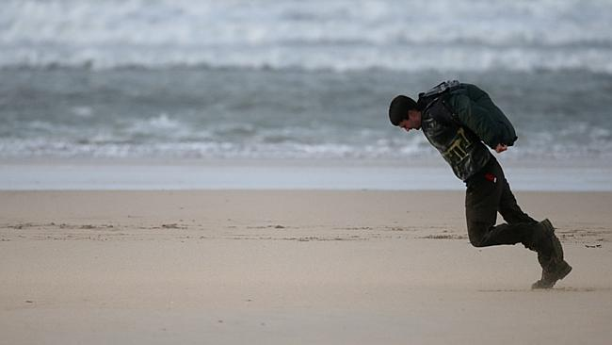
Wind is energy
It’s harder to walk against the wind – it takes more of your energy
Notes:
Walking into the wind is harder – it takes more of your energy

Slide 4
Wind is energy
Walking with the wind is easier – you can use some of its energy to move you forward
Notes:
Walking with the wind is easier – you can use some of its energy to move you forward

Slide 5
Wind is energy
We capture the wind’s energy to make things move.
The more energy we capture, the more power it can give us.

Slide 6
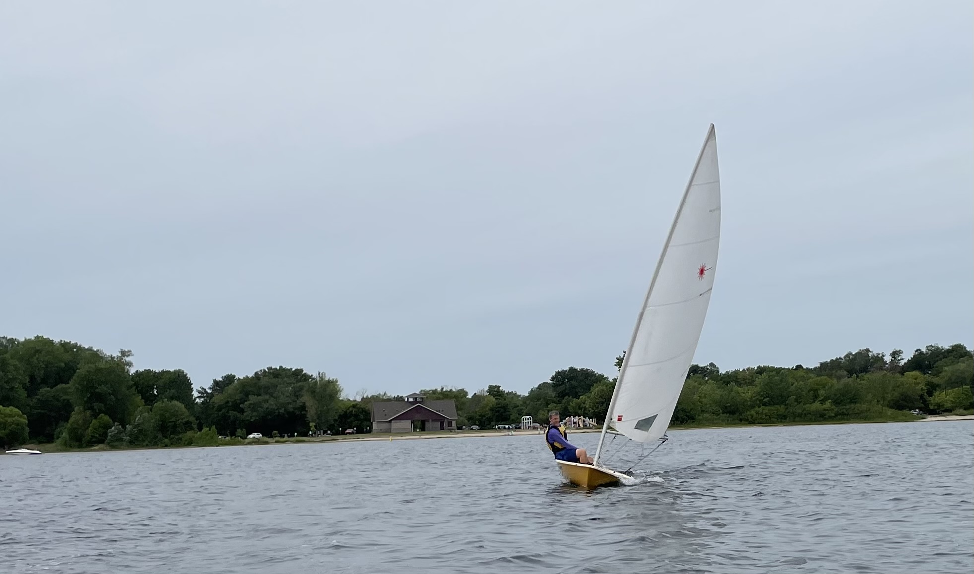
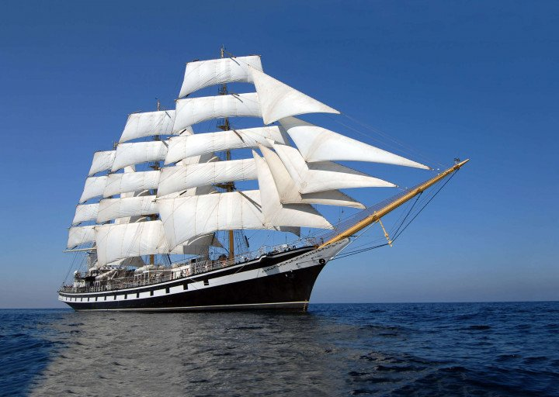
How does the wind make things move?
Notes:
Ask: Which ship do you think will capture more energy?

Slide 7
How does the wind make things move?
Energy to move forward = thrust
Thrust
Notes:
The energy that moves the sailboat forward is called thrust. Definition: Thrust is a force that propels an object forward.
Ask: Is there anything holding the boat back? (Answer: It has to push through the water.)

Slide 8
How does the wind make things move?
Resistance to moving forward = drag
Drag
Notes:
Drag is resistance to forward movement.

Slide 9
How does the wind make things move?
How do we move forward?
Thrust
Drag
Notes:
Ask: What is necessary for the ship to move forward? (Think about thrust and drag.)

Slide 10
How does the wind make things move?
How do we move forward?
Thrust
Drag
Notes:
For something to move forward, thrust has to be greater than drag.

Slide 11
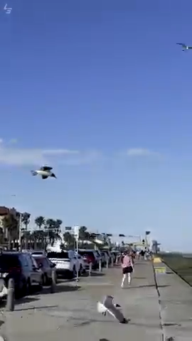
Thrust and Drag
Notes:
Ask: How do thrust and drag explain what is happening with these birds?

Slide 12
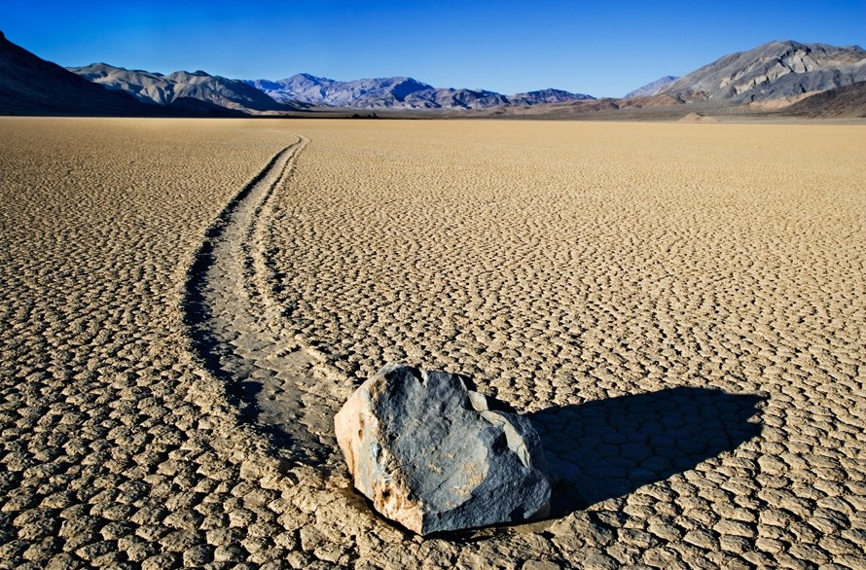
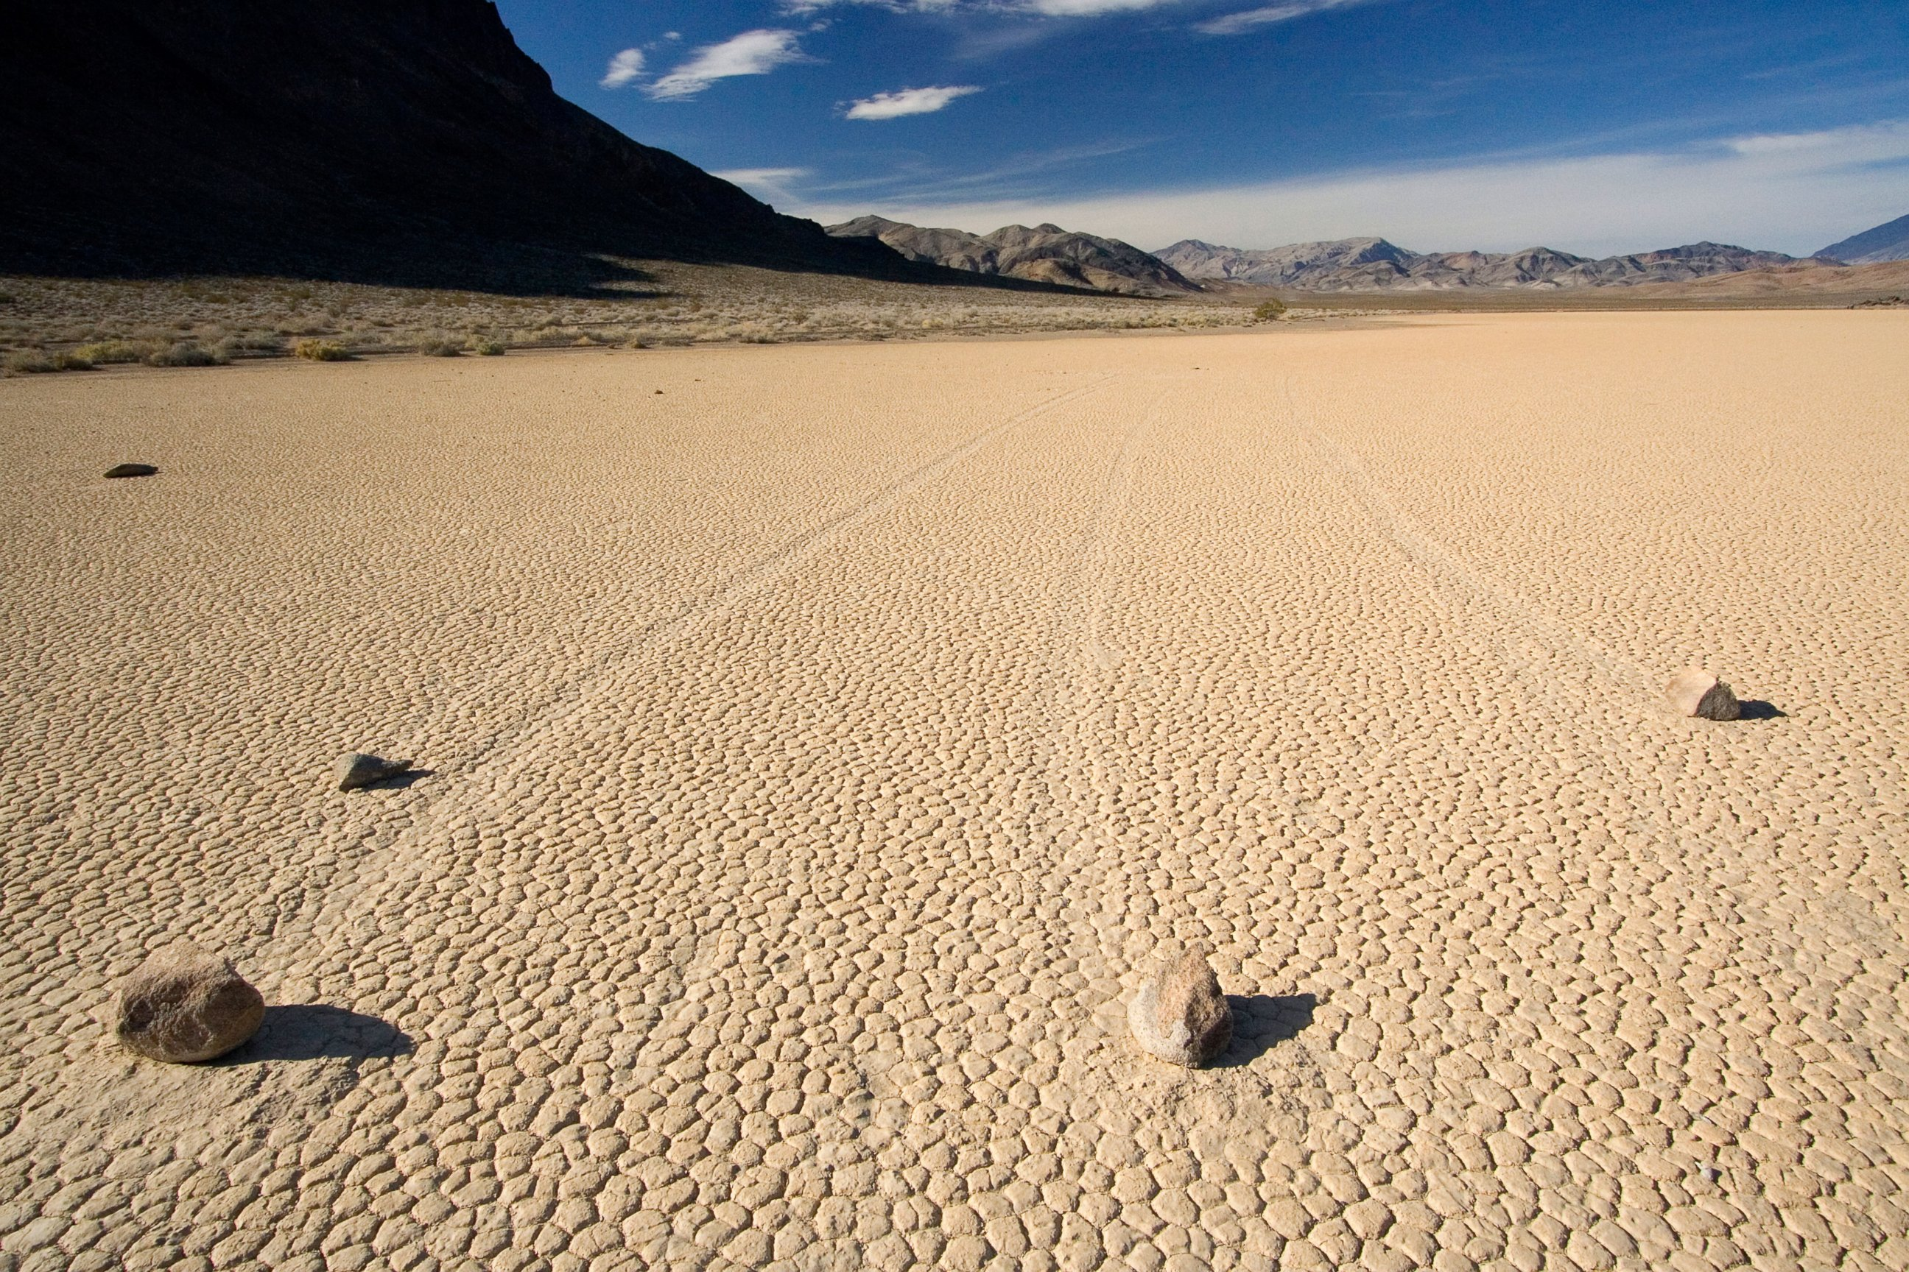
Thrust and Drag
Notes:
These rocks are in Death Valley in California. Researchers were stumped for a long time trying to figure out how these rocks seemed to move by themselves. There were no footprints near them. Finally, the researchers observed that when a thin layer of water covered the ground in this spot, the wind would push the rocks forward. Ask: How does this show thrust and drag?

Slide 13
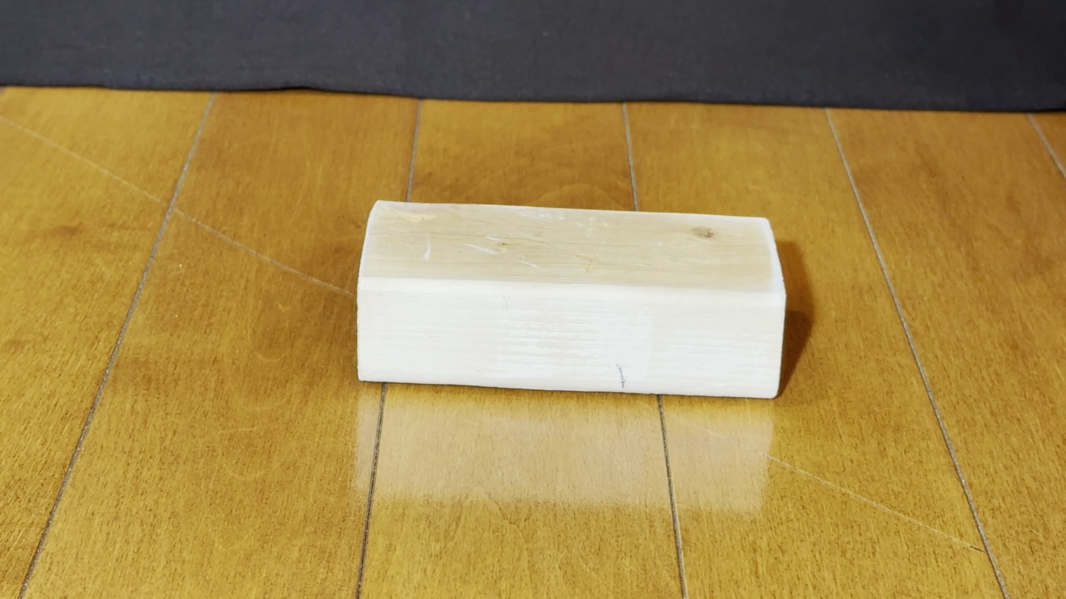
Can I move the block with wind power?
Notes:
Ask: What would it take for the wind to move this block of wood? Do you think it will work?

Slide 14
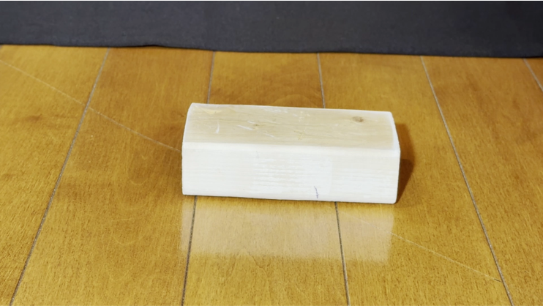
Can I move the block with wind power?
Thrust
Drag
Notes:
Ask: Why isn’t the block moving? (Drag is greater than thrust.) Now you try. Can you blow hard enough?

Slide 15
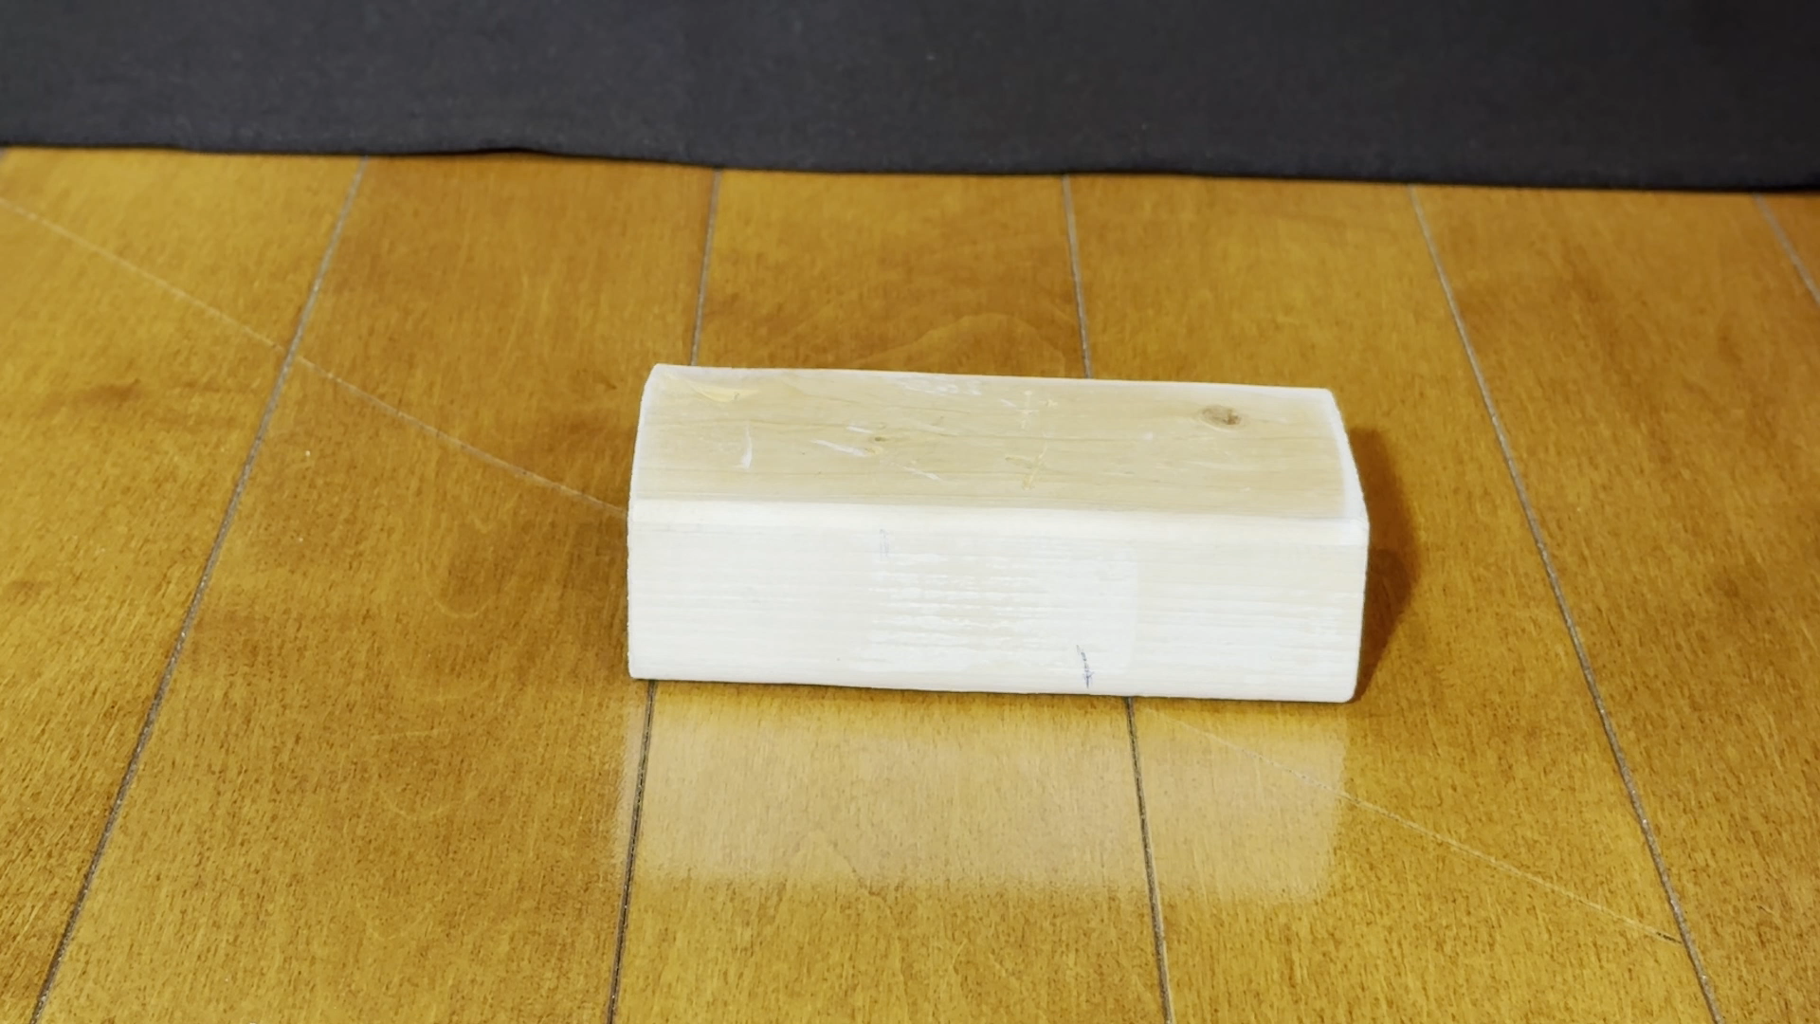
Can I move the block with wind power?
Notes:
Ask: What could we change to move the block? Let’s try adding more thrust. Maybe the wind isn’t enough.
Now you try pushing it. What do you think it takes more thrust to move the block? (Answer: When you push it, there’s enough thrust to overcome drag.)
Ask: How could we get it to move if we can’t increase thrust? (Answer: We could reduce drag.)
Let’s try reducing drag. The block is dragging against the floor. How can we reduce the drag?

Slide 16
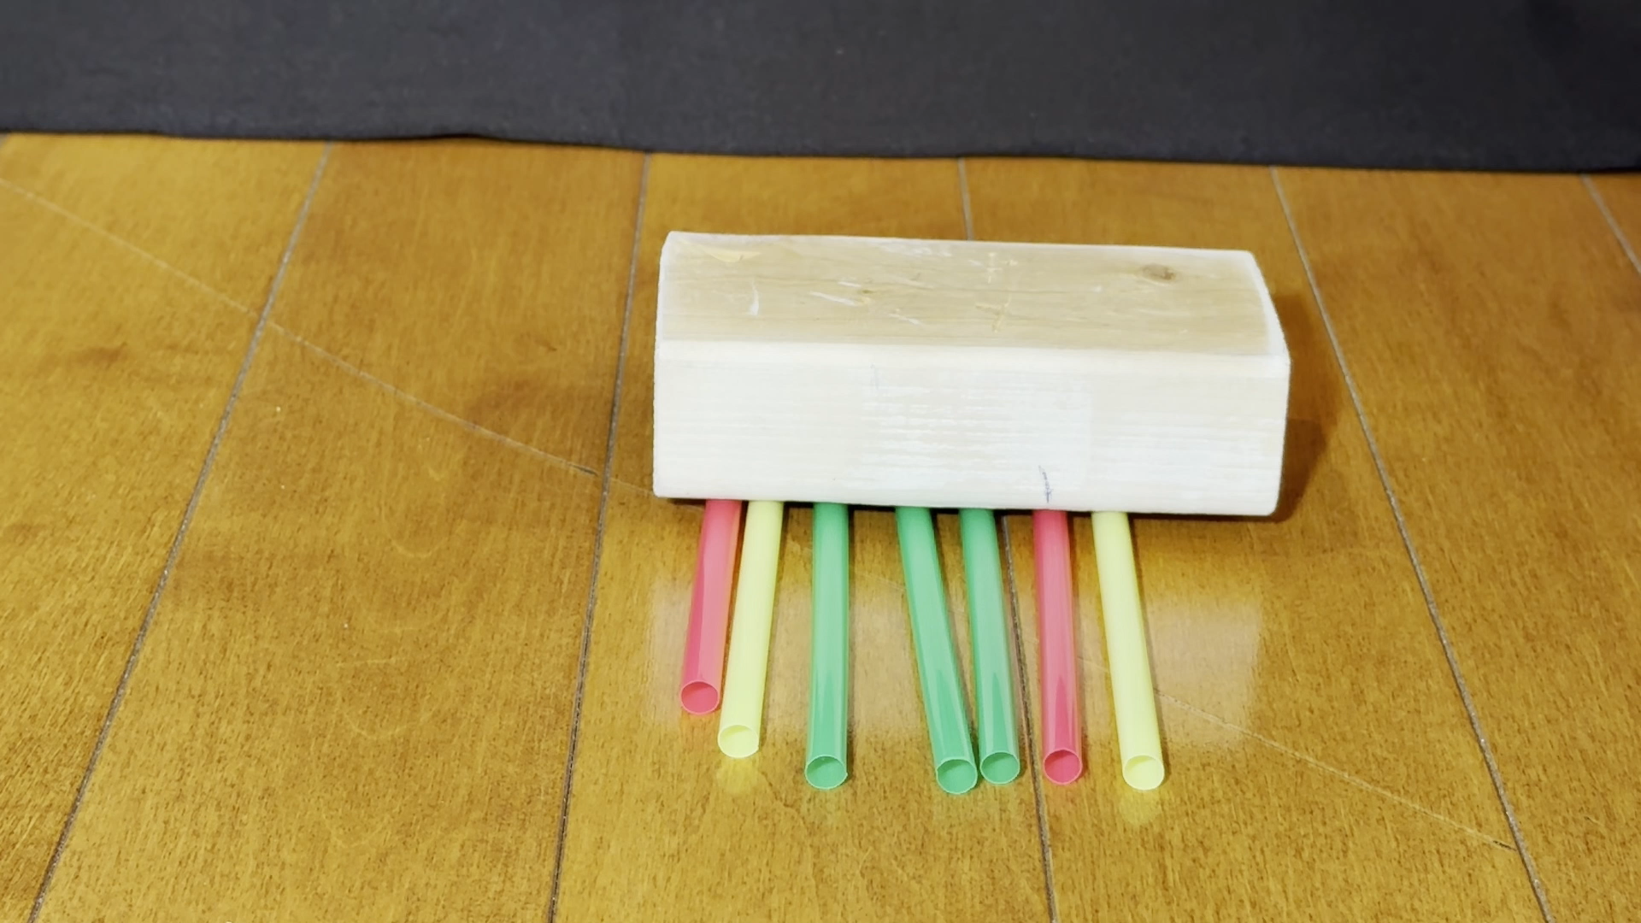
Can I move the block with wind power?
Notes:
Ask: Do you think these straws will reduce drag enough for the wind to move the block?
Now you try it.

Slide 17
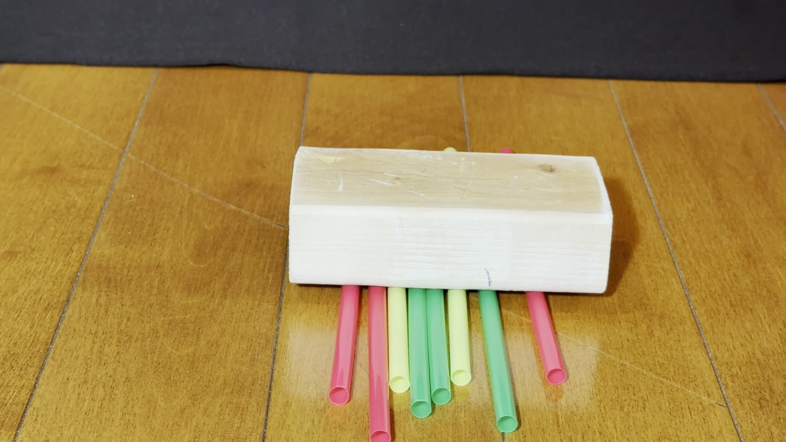
Can I move the block with wind power?
Notes:
Ask: What do you think will happen if we reduce drag AND increase thrust?
Now you try it.

Slide 18
How can we capture the wind’s energy?
Notes:
Ask: What could we do to really capture the wind’s energy for thrust? (Answer: Add a sail.)

Slide 19
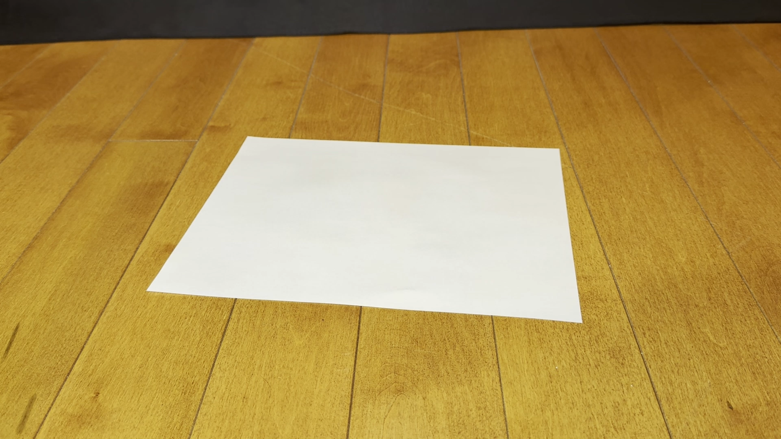
What kind of sail works best?
Notes:
Show three sheets of paper, one flat, one with a short sail, and one with a taller sail. Ask: Which sail do you think will work best? Demonstrate by blowing on the three sails.
The flat paper doesn’t really have a sail, so it can’t capture the wind’s energy for thrust. It also has the most drag.

Slide 20
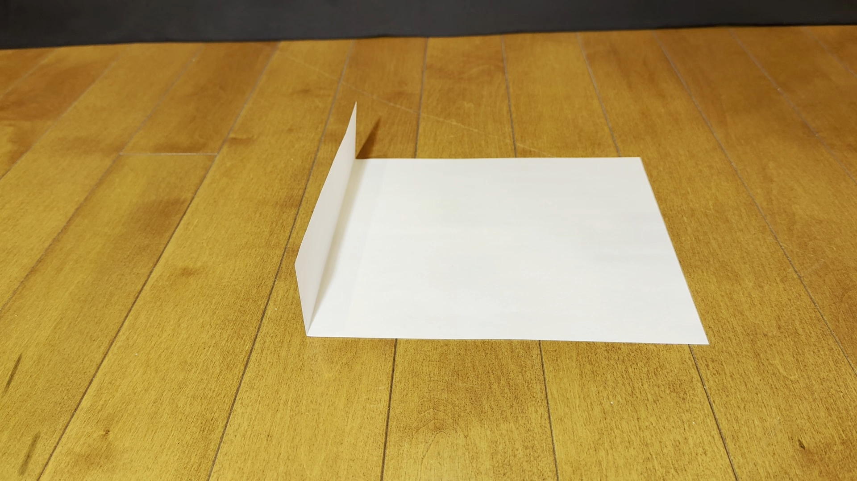
What kind of sail works best?
Notes:
The short sail captures some of the wind’s energy for thrust, and it has less drag against the floor.

Slide 21
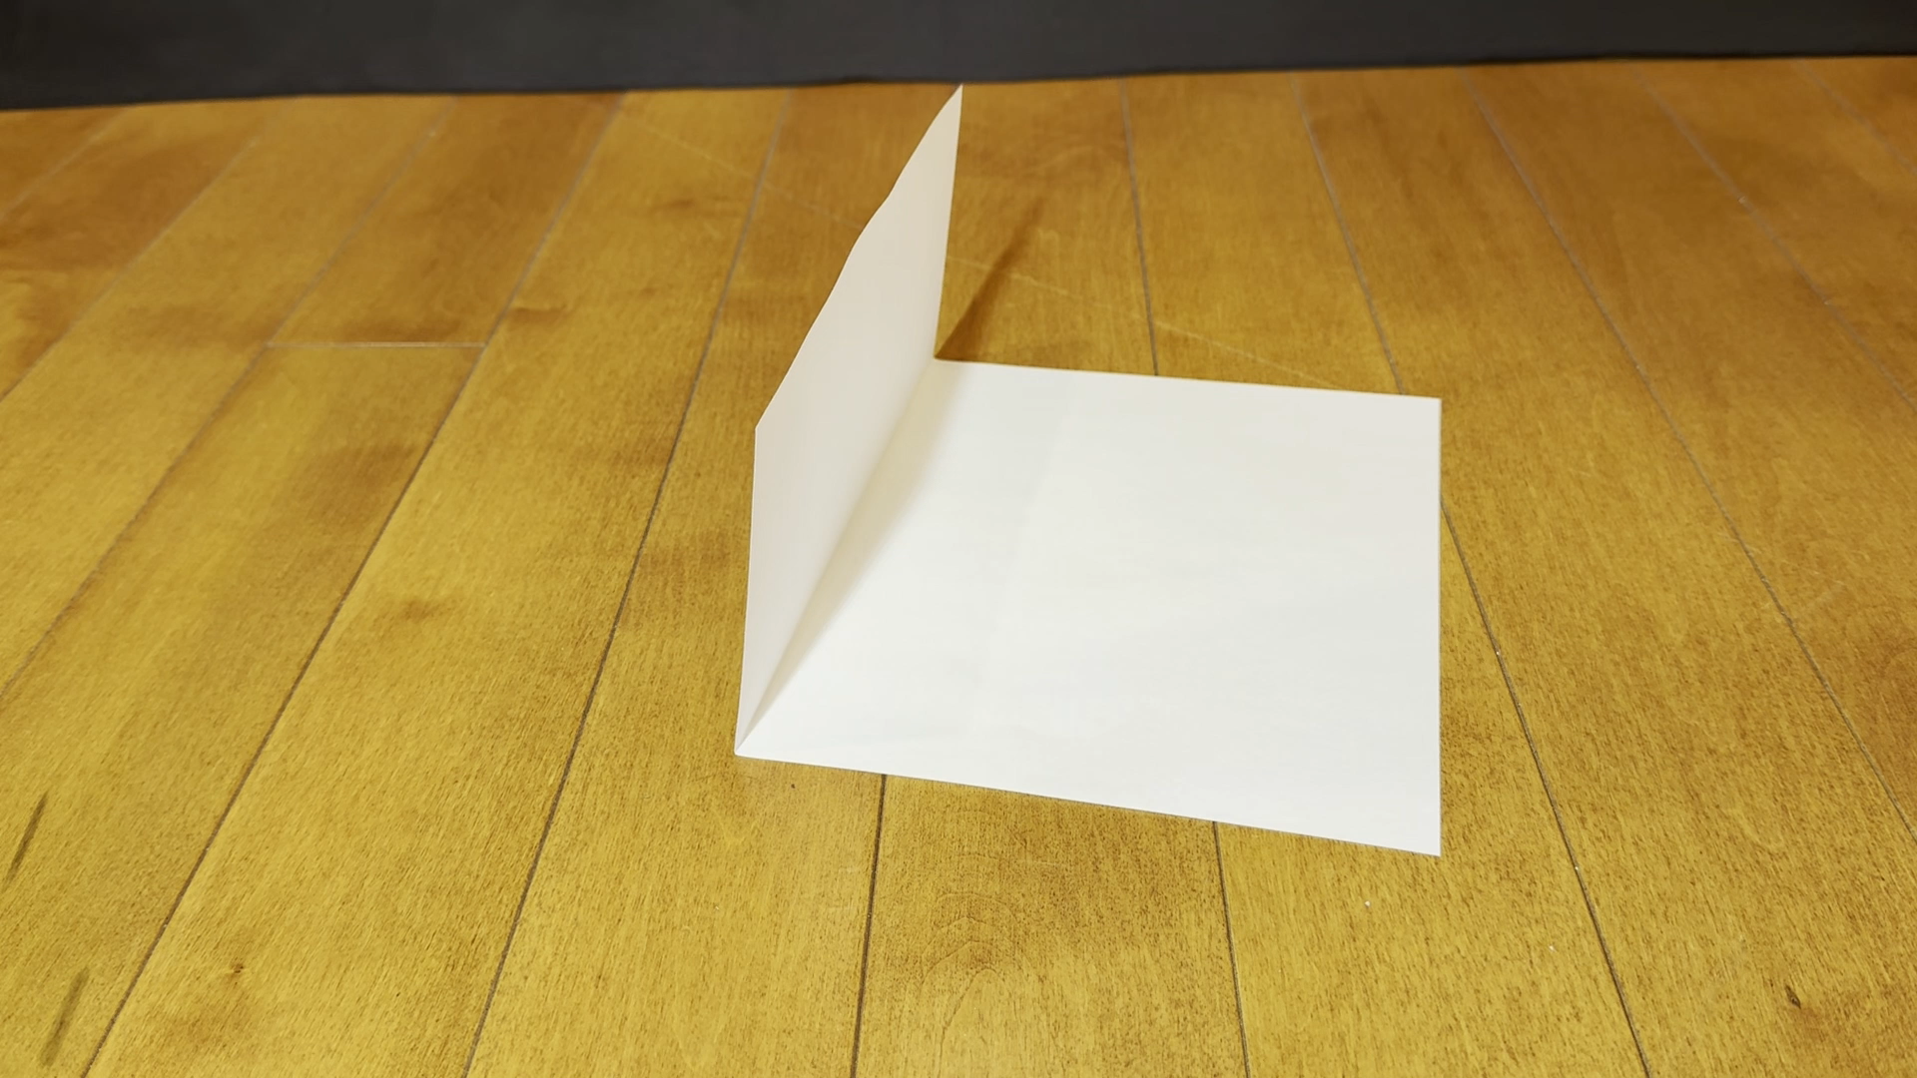
What kind of sail works best?
Notes:
The tall sail captures even more of the wind’s energy for thrust, and has the least drag against the floor.

Slide 22
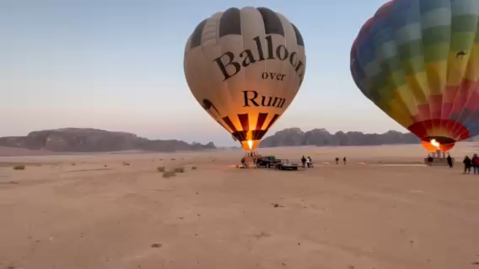
Using the wind for thrust
Notes:
Ask: What kinds of vehicles are powered by the wind?

Slide 23
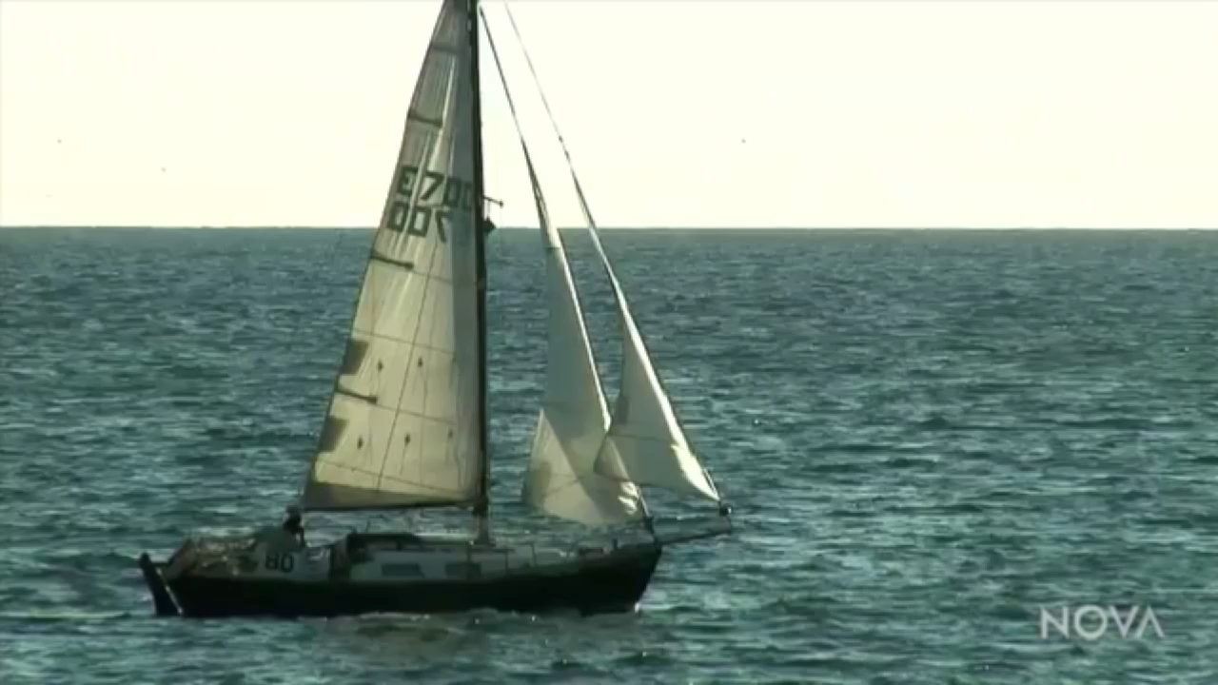
Using the wind for thrust
Notes:
Ask: What kinds of vehicles are powered by the wind?

Slide 24
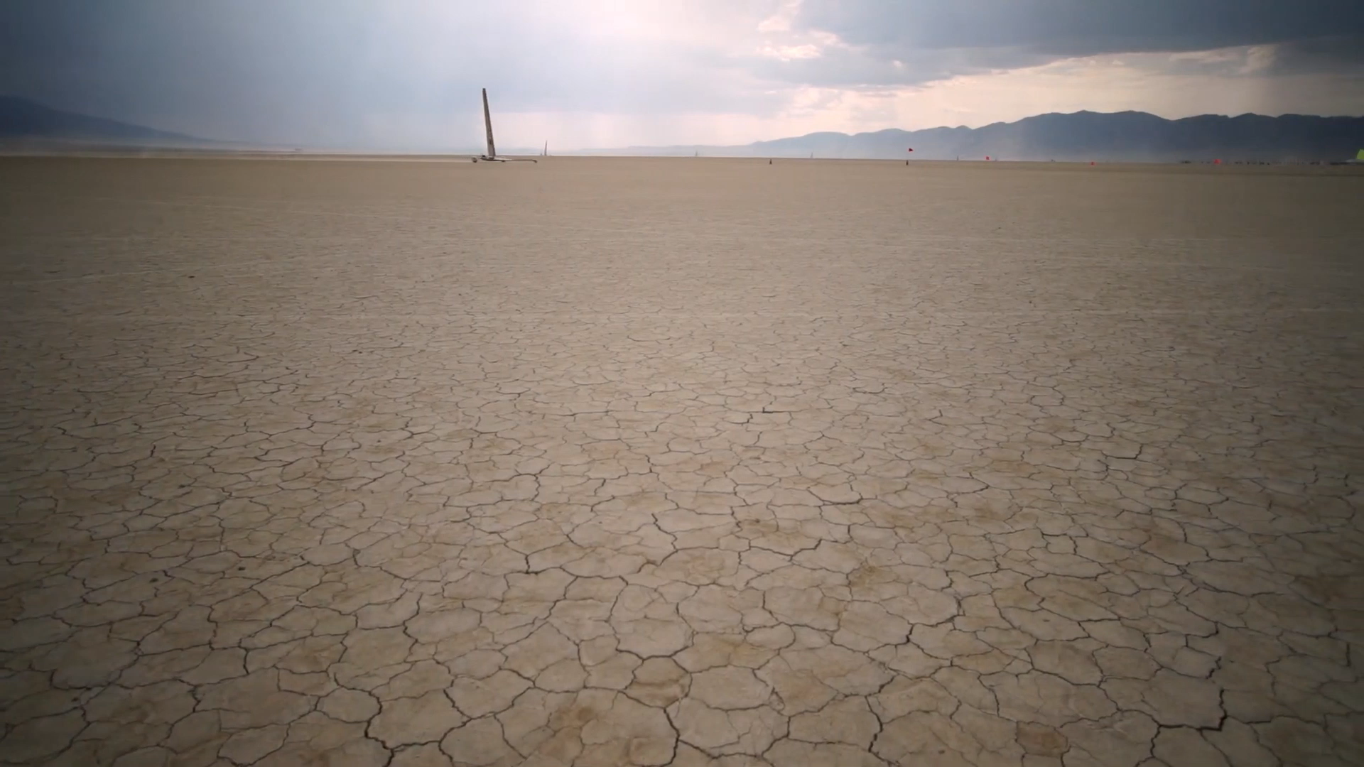
Using the wind for thrust
Notes:
Land sailing and sailboat racing both use wind to power the racers and competitive sports. Engineers understand how to harness the wind and reduce drag to get the most energy (thrust) out of the wind’s energy.

Slide 25
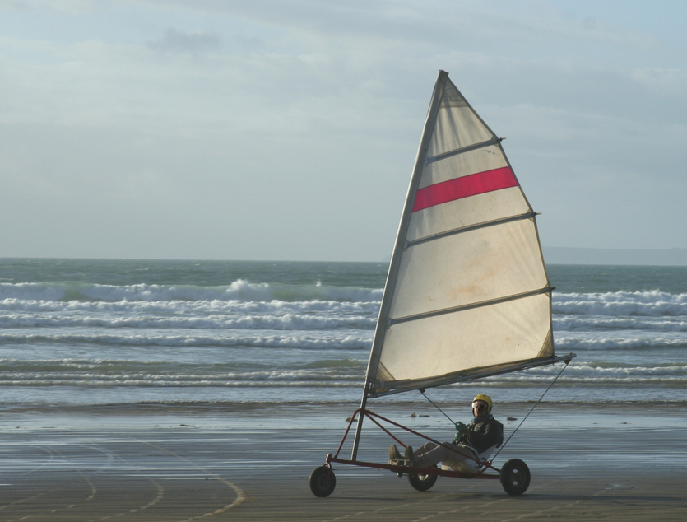
Engineering Challenge: Build a Wind Racer
Let’s build a Wind Racer!
Notes:
Today you will be an engineer that builds a wind racer. You need to build a racer that moves across the track using only wind as the source of power. You will get to test your vehicle to see how successfully it races.
Help the group consider how they can reduce drag, and how they can capture the wind’s energy.

